Slide 1
TDD, BDD, DevSecOps, SRE And VSCode (Refresher)

Slide 2
TDD Basics
When Is Your Software Reliable?
How To Make Your Software Reliable?

Slide 3
TDD Basics
Your Software is Reliable when it’s well tested but then you need to make your software testable
But How To Make Your Software Testable?

Slide 4
TDD Basics
Your Software is made (unit) testable using DI(Dependency Injection)
What are Mocks, Stubs & Fakes?

Slide 5
TDD Basics
Mocks Aren’t Stubs
Mocks | Stubs | Fakes
Mainly used to mock methods having return types | Mainly used to mock methods having no return type(i.e. void) | Mainly used to create fake objects/data that can serve as input(/output) to(/from) some function
AAA Pattern
Arrange
Act
Assert

Slide 6
TDD- AutoFixture
Life Before AutoFixture
- Lots of Boilerplate code(mainly in Arrange Part)
- BoilerPlate code example
DDD-Based-Enterprise-Application-Framework/Testing.Repository/EFRespositoryAndUnitOfWorkTest.cs at master · sandipray63in/DDD-Based-Enterprise-Application-Framework · GitHub
Life After AutoFixture
- Most of the Boilerplate code handled automatically

Slide 7
TDD- AutoFixture
What’s the Frozen Attribute?
- To whichever function parameter Frozen attribute is applied, that will act as a singleton instance.

Slide 8
TDD- Nsubstitue
What’s the Substitute Attribute?
- When used alongwith AutoFixture, to whichever function parameter Substitute Attribute is applied, a mock object is created with default values for the state of the object
- But the SUT(Subject Under Test) class should be the last parameter of the function & all dependencies of that class should be declared before that.

Slide 9
TDD - Persistance
The idea is to have an in-memory representation of the actual persistance store & do CRUD operations over the in-memory persistance
EF Persistance Example
DDD-Based-Enterprise-Application-Framework/Testing.Repository/App.config at master · sandipray63in/DDD-Based-Enterprise-Application-Framework · GitHub

Slide 10
TDD - Persistance
Some Other Examples
To mock CRM IOrganizationService, can use -
FakeXRMEasy (but that’s now paid)
XrmUnitTest (free Open Source alternative)
GitHub - daryllabar/XrmUnitTest: Xrm Unit Testing Framework With "In Memory" CRM server
For Further Exploration
Index at XUnitPatterns.com
Parameterized Unit Tests in .NET 7 with xUnit | by Roko Kovač | Medium
xUnit Autodata with autofixure

Slide 11
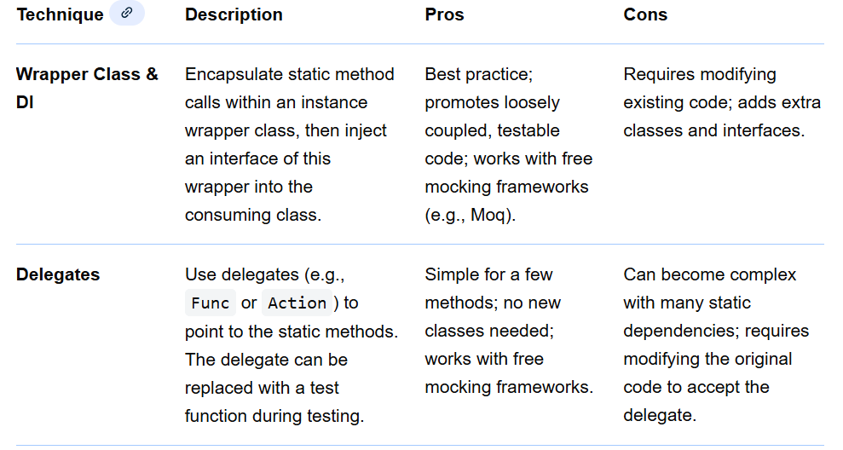
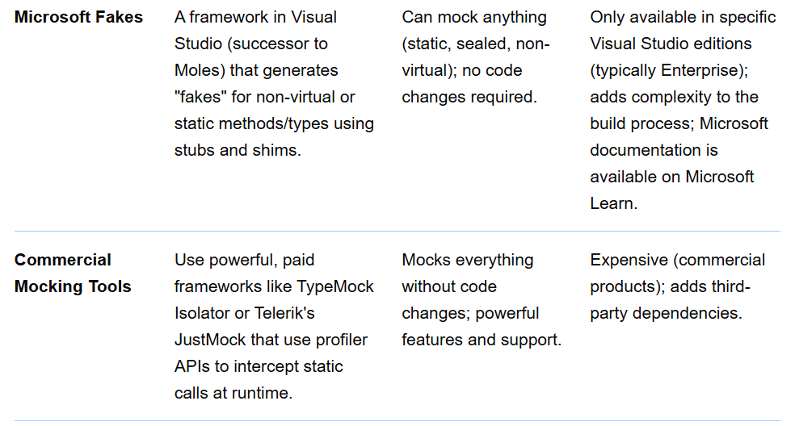
TDD – Mocking & Unit Testing Static Classes, Variables and Methods

Slide 12
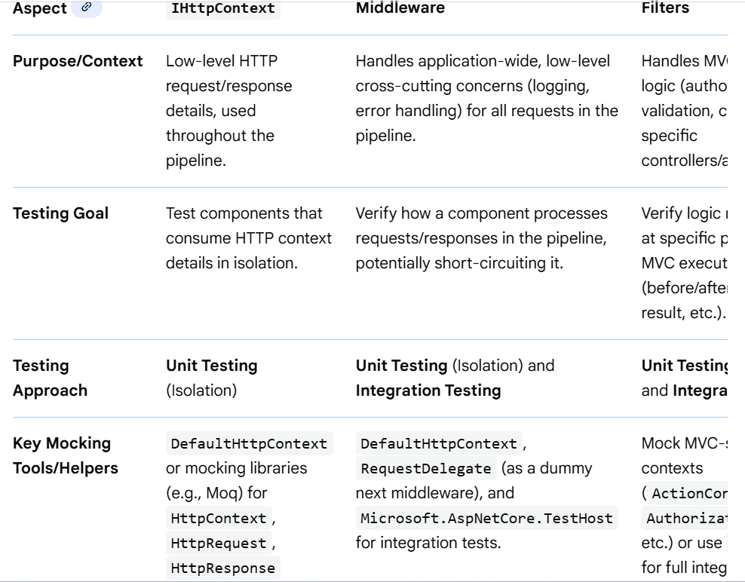
TDD – Some Tricky ASP.NET Core Constructs

Slide 13
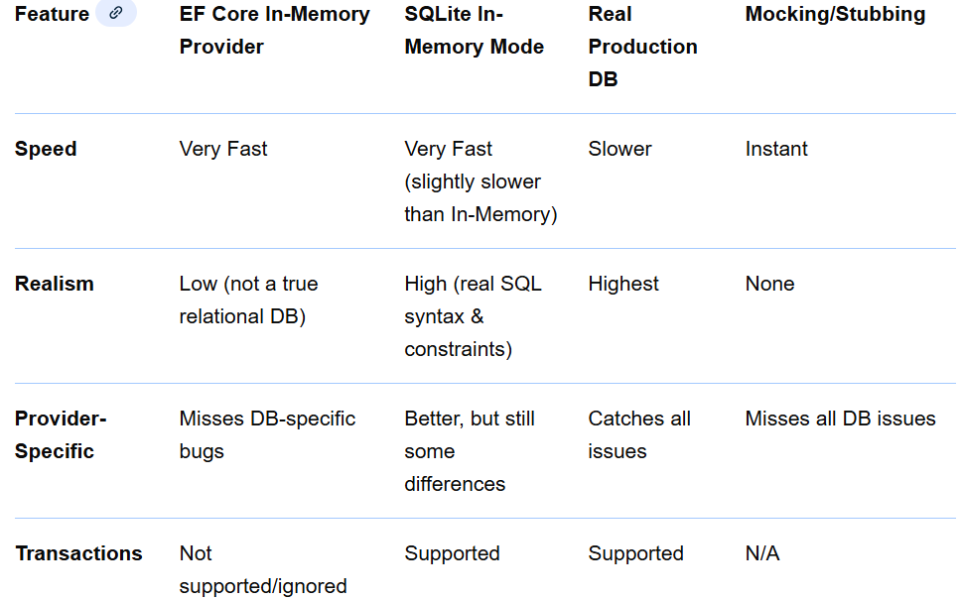
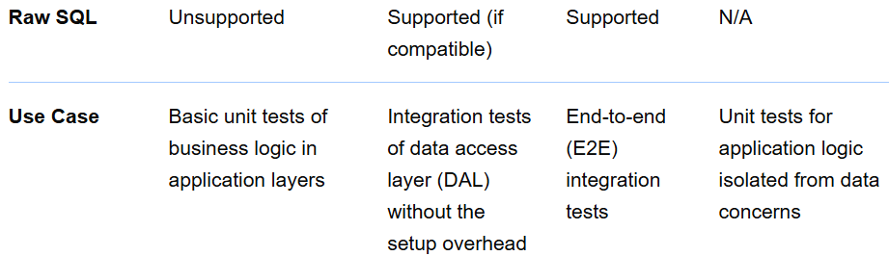
TDD – EF Core Testing Strategies

Slide 14
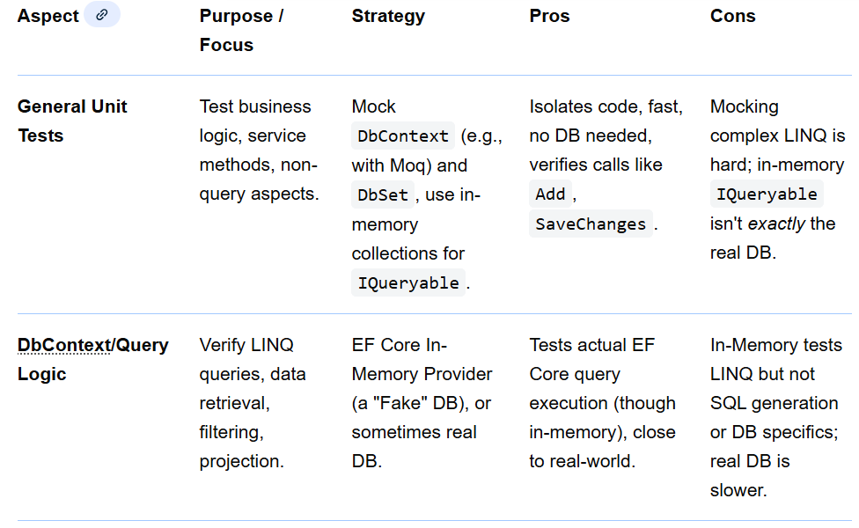
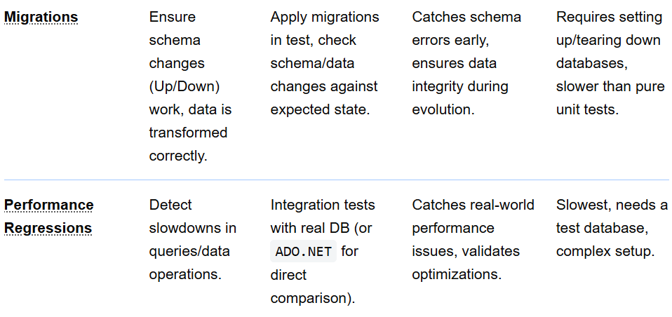
TDD – Some Mocking & Unit Testing Use Cases in EF Core

Slide 15
BDD- Basics
Mainly used for E2E Integration Testing.
But can serve as User Acceptance Documentation as well
Also, E2E Functional Automation Testing can be done using BDD. Most of the new age Functional Automation Testing Tools in the market are BDD based.

Slide 16
BDD- Gherkin
The Gherkin Language
Given
When
Then
Example (using SpecFlow)
WeatherForecastAzureFunctionAndAngularSample/WeatherForecastBDD at master · sandipray63in/WeatherForecastAzureFunctionAndAngularSample · GitHub
For Further Exploration
Specflow Examples — documentation
Samples - Reqnroll Documentation

Slide 17
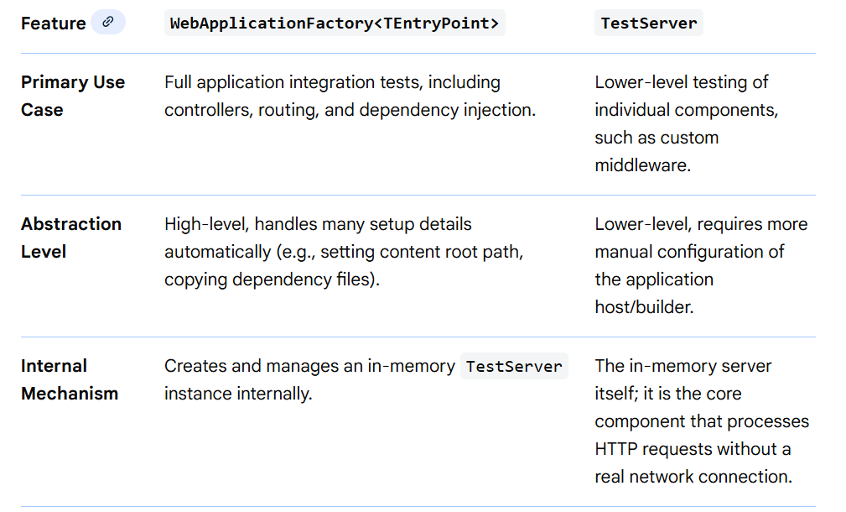
BDD- ASP.NET Core Integration Testing Techniques

Slide 18
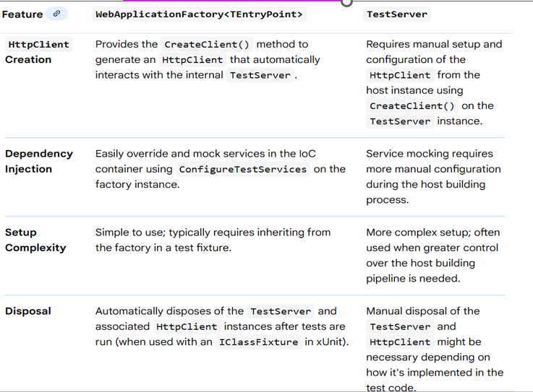
BDD- ASP.NET Core Integration Testing Techniques
For Further Exploration
Integration tests in ASP.NET Core | Microsoft Learn

Slide 19
TD & BDD- Katas
Katas to learn TDD
Katas to practice BDD

Slide 20
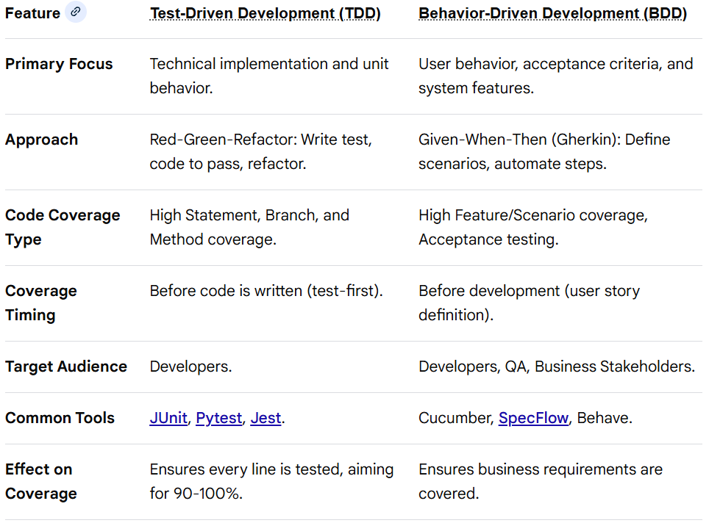
TDD and BDD Code Coverage
TDD and BDD provide high code coverage by ensuring testing precedes or defines development, focusing on unit-level precision (TDD) and user-scenario behavior (BDD). TDD relies on unit tests (JUnit/Pytest) to achieve high line/branch coverage, while BDD uses Gherkin-based scenarios (Cucumber) to ensure behavior-driven coverage, reducing redundant code.

Slide 21
TDD and BDD Code Coverage
TDD & BDD Integration for Optimal Coverage
Layered Approach: Use BDD to define high-level feature coverage and TDD to ensure 100% path coverage for the implementation of those features.
Iterative Cycles: In BDD, each step definition should ideally be developed using TDD.
Refactoring: TDD’s refactoring phase ensures that as coverage increases, the code quality remains high without breaking existing functionality.
Typical Workflow for High Coverage
Define BDD Feature: Write Gherkin (Given, When, Then) for a user story.
TDD Cycle for Step Definitions: For each step in the BDD scenario, write a failing unit test.
Implement Code: Write the minimum code to make the unit test pass.
Refactor: Optimize the code while keeping tests passing.
Run All Tests: Ensure both unit tests (TDD) and scenario tests (BDD) pass.

Slide 22
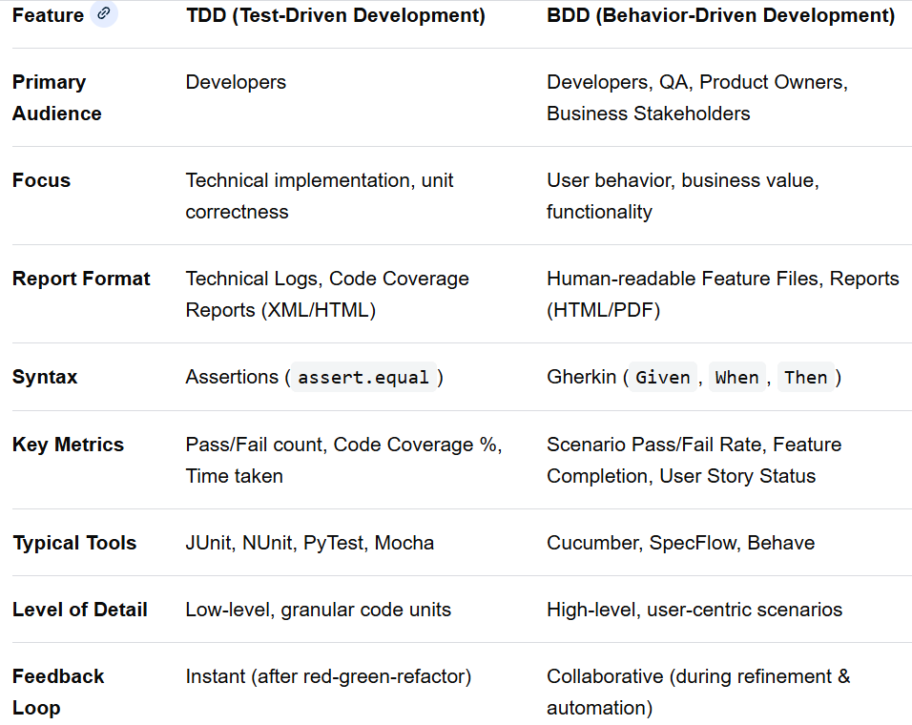
TDD and BDD Reporting
TDD and BDD reporting differs by audience and scope: TDD produces technical, developer-centric reports focused on unit-level pass/fail rates, while BDD delivers business-readable, scenario-based reports (Gherkin syntax) highlighting user behavior. Key tools include JUnit/NUnit for TDD, and Cucumber/SpecFlow for BDD, typically integrated into CI/CD pipelines.

Slide 23
TDD and BDD Reporting
Exhaustive TDD Results Reporting Breakdown
Format: Primarily textual logs in IDE, or JUnit XML format, often converted to HTML via CI/CD tools like Jenkins.
Key Data Points:
Class/Method Name: Which function was tested.
Assertion Failures: Specific value mismatches (Expected X, got Y).
Execution Time: Milliseconds per test.
Stack Trace: Line number of failure.
Exhaustive BDD Results Reporting Breakdown
Format: HTML reports generated by Cucumber/SpecFlow, often interactive, allowing stakeholders to drill down into failures.
Key Data Points:
Feature/Scenario Name: Describes the business requirement.
Given-When-Then Steps: Shows which step in the scenario failed.
Steps Definitions Mapping: Links Gherkin to code.
Screenshots/Videos: Captured upon failure for UI scenarios.

Slide 24
TDD and BDD Reporting
Best Practices for Reporting
Automate in CI/CD: Integrate tests into pipeline (e.g., Jenkins, GitHub Actions) for automatic report generation upon commits.
Centralized Dashboards: Use tools like Allure or ExtentReports to aggregate results for both TDD and BDD in one view.
Keep BDD Readable: Ensure Gherkin scenarios are non-technical so non-developers can understand the report.
Monitor Trends: Track failed scenarios over time, not just in the current build.
For Further Exploration
Allure Report — Open-source HTML test automation report tool
Test automation reporting improvements through Allure

Slide 25
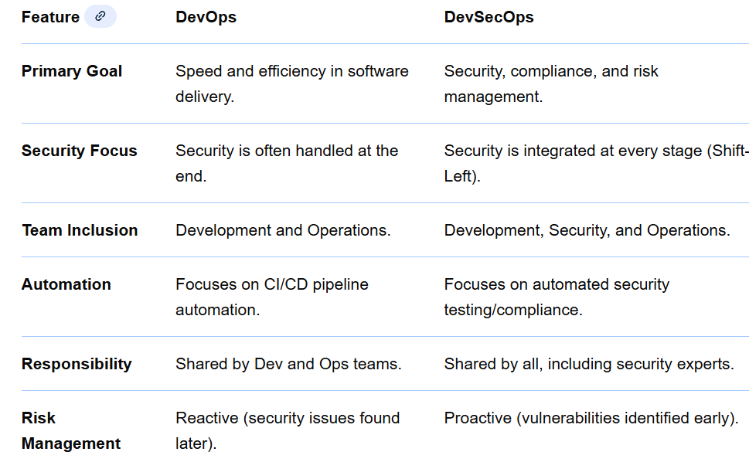
DevSecOps
Key Differences in Approach
Security Integration: DevOps focuses on the "how" of building, while DevSecOps focuses on the "how" of building securely.
Cultural Shift: DevSecOps treats security as code, ensuring every team member is responsible for security, not just a siloed security team.
Velocity vs. Security: While DevOps can sometimes sacrifice security for speed, DevSecOps aims to balance both, ensuring speed does not introduce vulnerabilities.

Slide 26
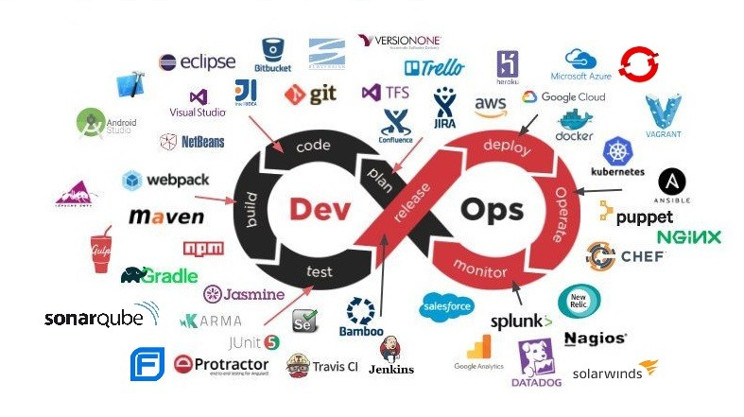
DevSecOps
Lifecycle

Slide 27
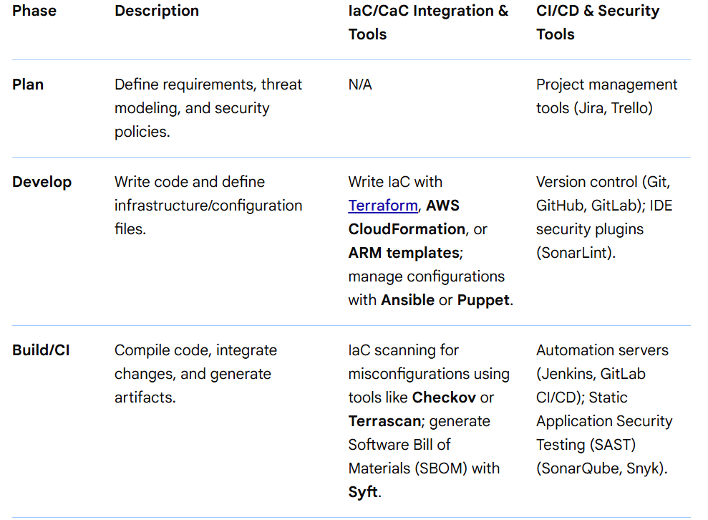
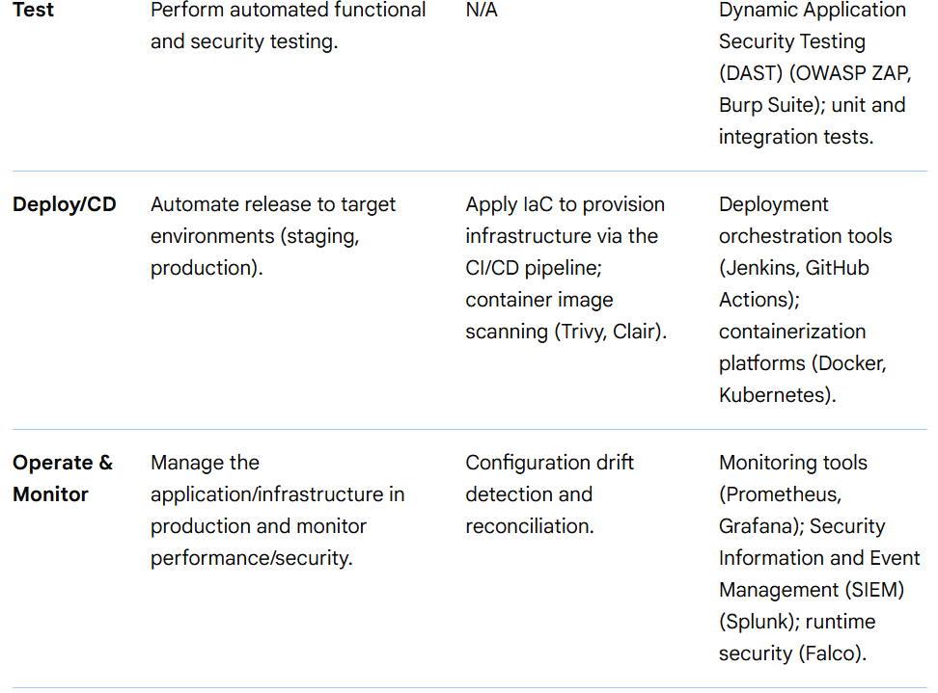
DevSecOps
Lifecycle
A DevSecOps lifecycle integrates security into every phase of the software delivery pipeline, which includes practices like Infrastructure as Code (IaC) and Configuration as Code (CaC), orchestrated through CI/CD tools.

Slide 28
DevSecOps
Key Principles Illustrated in the Lifecycle(in earlier slide)
"Shift Left": Security is integrated into the earliest stages (Plan and Develop) rather than being an afterthought.
Automation: CI/CD pipelines automate security scanning and policy enforcement throughout the workflow, ensuring consistency and speed.
Everything as Code: Infrastructure (IaC) and configuration (CaC) are treated as version-controlled code, allowing security policies to be written and automated as "policy as code".
Continuous Feedback Loop: Monitoring in the production stage feeds back into the planning stage, ensuring continuous improvement of the security posture.
This lifecycle transforms security from a potential bottleneck into an accelerator for secure, rapid software delivery.

Slide 29
DevSecOps
Lifecycle
For Further Exploration -
What is DevOps?? | GitLab
What is CI/CD | LinkedIn
Automate DACPAC Creation and Setup Scripts for Database Development
pgAdmin - PostgreSQL Tools
DevSecOps on Azure | Microsoft Learn
Security in DevOps (DevSecOps) - Azure DevOps | Microsoft Learn
DevSecOps for Infrastructure as Code (IaC) - Azure Architecture Center | Microsoft Learn
Quality Gates: Why your DevOps Pipeline needs them! - Quality Clouds
Everything as code - DevOps Guidance
Features and benefits of Red Hat OpenShift
Getting GitOps: A practical platform with OpenShift, Argo CD, and Tekton | Red Hat Developer
DevOps Culture and Practice with OpenShift | Red Hat Developer
E-books - Practical DevSecOps
Hands-On Security in DevOps | Cloud & Networking | Paperback
Shift left vs shift right: A DevOps mystery solved
Accelerate [Book](Check DORA[DevOps Research and Assessment] Metrics)

Slide 30
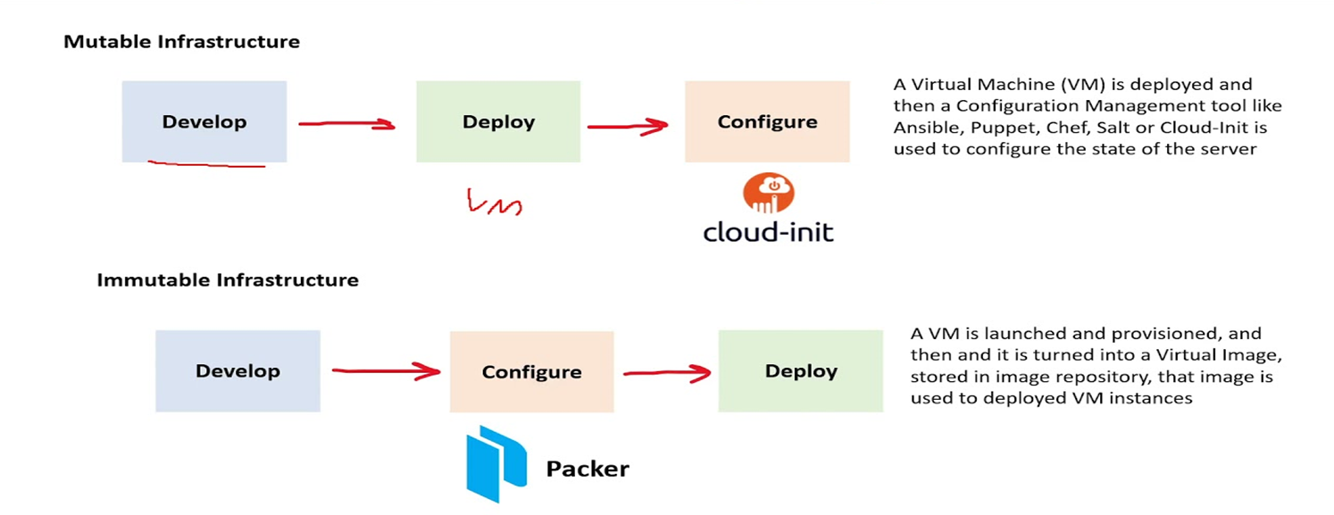
DevSecOps
Immutable Infrastructure
For Further Exploration –
Immutable Infrastructure: Benefits, Comparisons & More

Slide 31
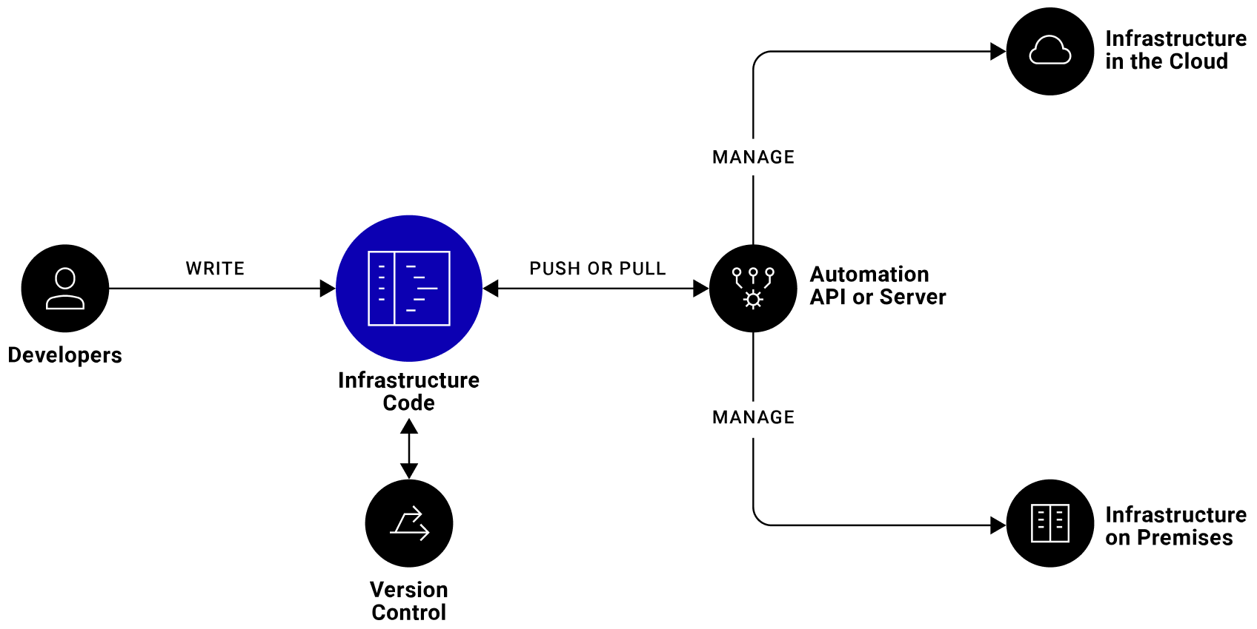
DevSecOps
IaC(Infrastructure as Code)
For Further Exploration -
Infrastructure as Code (IaC) vs. Configuration as Code (CaC)
Configuration as Code: Everything You Need to Know
GitOps vs GitFlow
WarpBuild - 10x faster, 90% cheaper Github Actions runners
Comparing Terraform and Bicep | Microsoft Learn
The Complete Terraform with Ansible Bootcamp 2025 | Udemy
Infrastructure-as-Code-for-Beginners
Mastering-Terraform
Terraform-Cookbook
Master Azure Bicep: Explore Advanced Features and Techniques | Udemy
Azure Bicep: Mastering Infrastructure as Code with Bicep | Udemy
Infrastructure-as-Code-with-Azure-Bicep
Terraform vs. Pulumi IaC | Pulumi Docs

Slide 32
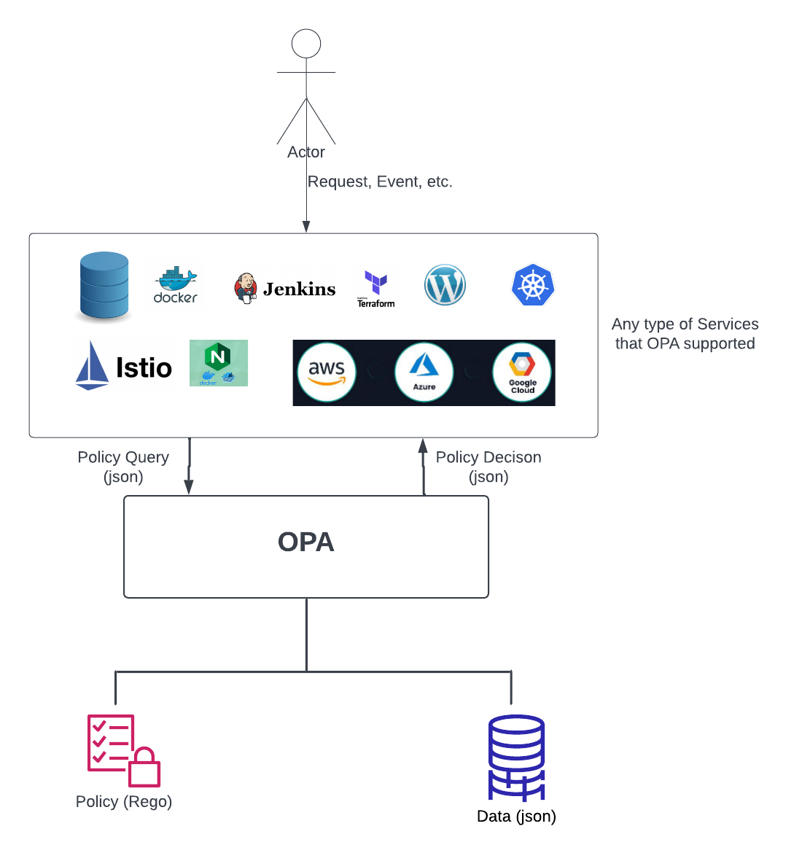
DevSecOps
Policy as Code -
Policy as code is not only used exclusively for AuthN and AuthZ; it is a broader concept applied to managing infrastructure and operations, including infrastructure provisioning, workload orchestration, and a wide range of other operational concerns beyond just security access controls. While it is a powerful tool for implementing complex AuthN and AuthZ policies, its primary purpose is to bring code-like management to any form of operational policy.

Slide 33
DevSecOps
Policy as Code –
How Policy as Code is Used: Infrastructure Management: Defining and enforcing policies for provisioning and configuring infrastructure resources. Workload Orchestration: Managing and governing the deployment and execution of workloads and applications. Security: Implementing AuthN and AuthZ policies to control access to resources and ensure compliance. Compliance: Automating the enforcement of regulatory and organizational compliance requirements. Cost Management: Setting policies to control cloud spending and resource utilization. Why it Extends Beyond Security: The term "policy as code" signifies the process of defining, managing, and versioning any kind of policy using code, similar to how software is developed.
This allows for: Automation: Policies are automatically enforced, reducing manual effort and human error. Version Control: Policies can be tracked, audited, and rolled back to previous versions, just like code. Scalability: Policies can be applied consistently across large and complex infrastructures. Flexibility: The same framework can be used for various operational concerns, not just security.
For Further Exploration –
What is Policy-as-Code? | Sysdig
Infrastructure as Code Testing with Azure Policy | Microsoft Community Hub
Policy Design in the Age of Digital Adoption | Cloud & Networking | Print

Slide 34
DevSecOps
APIOps
✅ What is APIOps?
APIOps is to APIs what DevOps is to software.
DevOps = Automate building & deploying code.
APIOps = Automate designing, publishing & managing APIs.
Think of APIOps as:
A repeatable, automated, version-controlled workflow to design, test, secure, deploy, and govern APIs.
🤔 Why Was APIOps Needed?
Traditional APIs were deployed like this:
Developer writes API code
Writes documentation later (maybe 😅)
Manually configures gateway policies
Pushes to production
Teams struggle to maintain consistency
This causes:
Different APIs behave differently
Security policies are inconsistent
Breaking changes happen silently
Nobody knows which version does what
Time to market is slow
APIOps solves this by standardizing and automating the entire lifecycle.

Slide 35
DevSecOps
APIOps
🧠 Core Mindset Behind APIOps
Traditional API Development APIOps Way
Manual configuration Automated pipelines
Docs are afterthought API design-first
Inconsistent policies Central policy enforcement
Hard to track changes Version-controlled API definitions
Deployment is risky Incremental, tested releases
🧱 The Three Pillars of APIOps
Pillar | Meaning | Example Tools
Design-First | API contract written before implementation | OpenAPI, Swagger, Postman Collections
GitOps for API Objects | Treat API definitions as code stored in Git | GitHub, GitLab, Bitbucket
Automated API Release Pipelines | Deploy APIs using CI/CD pipelines | Azure DevOps, GitHub Actions, Jenkins

Slide 36
DevSecOps
APIOps
🚦 The APIOps Lifecycle (Very Important)
Design → Validate → Secure → Test → Publish → Monitor → Improve → Version → Repeat
1. Design
Write API spec in OpenAPI (YAML/JSON)
Define endpoints, request/response schemas, error codes
2. Validate
Check naming conventions
Enforce versioning strategy
Ensure proper status codes
Validate API structure automatically
3. Secure
Apply API gateway policies:
Rate limiting
JWT validation
OAuth2 token enforcement
IP allow/deny
WAF integration
4. Test
Contract tests (Does API follow spec?)
Functional tests (Does it behave correctly?)
Performance tests (Does it scale?)

Slide 37
DevSecOps
APIOps
5. Publish
Deploy to:
Gateway (Azure APIM, Kong, Apigee, Nginx)
Developer Portal (Docs are auto-generated!)
6. Monitor
Latency
Errors per endpoint
Traffic patterns
7. Improve
Use metrics + logs to refine usage
8. Version
Support parallel versions when breaking changes happen
🔁 A Typical APIOps Pipeline (Concrete Example)
When a developer commits openapi.yaml to Git —
Step Action Tool
1 Lint spec Spectral, Redocly
2 Generate mock APIs Prism / WireMock
3 Run contract tests Postman/Newman
4 Deploy to dev gateway CI/CD Pipeline
5 Apply security policies automatically APIM / Kong
6 Run end-to-end smoke tests K6 / JMeter
Promote to staging/production after approval GitOps deployment workflow
Everything happens automatically Consistent every time.

Slide 38
DevSecOps
APIOps
🏛️ Governance in APIOps
Governance ensures all APIs follow rules:
Policy Category Examples
Naming /customers/{id} not /getCustomerData
Versioning /v1/, /v2/
Security OAuth2 required on all production APIs
Error Format Standard JSON error bodies
Documentation Must auto-generate
Governance is enforced through tools + pipelines, not meetings.
🧰 Reference Architecture for APIOps
Developers → Git (API Spec) → CI Pipeline → API Linter → Tests
↓
API Gateway (APIM/Kong/Apigee)
↓
Developer Portal + Monitoring
🎯 Practical Tools You Will Actually Use
Function Tools
API Design SwaggerHub, Postman, Stoplight
API Validation Spectral, Redocly, Schemathesis
CI/CD GitHub Actions, Azure DevOps, GitLab CI
API Gateways Azure API Management, Kong, Apigee, AWS API Gateway
Observability Prometheus, Grafana, Splunk, APIM Analytics

Slide 39
DevSecOps
APIOps
🌍 Real-World Example Scenario
A bank exposes account lookup API to fintech partners.
With APIOps:
API spec is versioned in Git
Every change triggers open API validation & security review pipeline
Published docs update automatically on the Partner Developer Portal
Monitoring triggers alerts if latency spikes
Breaking change? → Create /v2/ and deprecate /v1/ cleanly
This improves:
Security
Compliance
Time-to-market
Developer trust
🎁 Summary (Memory Shortcut)
APIOps = OpenAPI + Git + CI/CD + API Gateway Policies + Automated Documentation + Monitoring
If a process involving APIs is manual → automate it.

Slide 40
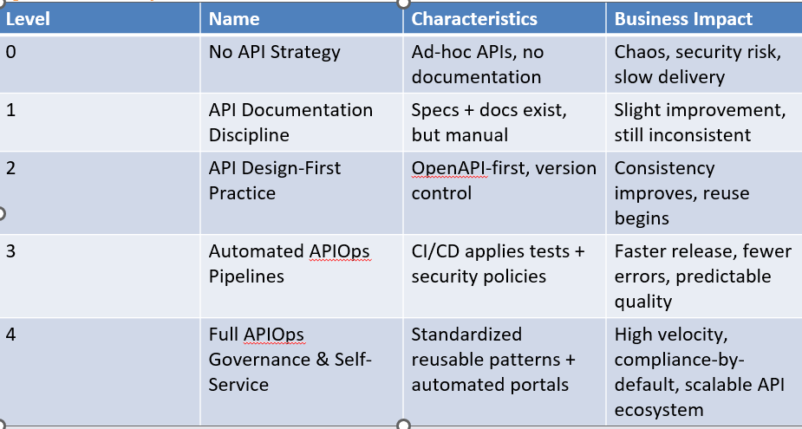
DevSecOps
APIOps
🚀 APIOps Maturity Roadmap (Enterprise-Ready)
In general, 5 maturity levels:

Slide 41
DevSecOps
APIOps
🎨 Visual Roadmap Summary (Memory Snapshot)
Level 0 → No Strategy → Chaos
Level 1 → Documentation → Visibility
Level 2 → Design-First → Consistency
Level 3 → Automated APIOps Pipelines → Quality + Speed
Level 4 → Governance + Self-Service → Scale + Reliability.
For Further Exploration
Guide to APIOps, the Collaborative Approach for API Production
APIOps: Transforming API Development with DevOps Principles
Automated API deployments using APIOps
APIOps – Documentation
APIOps-Lab
APIQuality - APIOps Low Code with artificial intelligent

Slide 42
DevSecOps
WorkerOps
1. APIOps Recap
APIOps applies DevOps-like practices specifically to APIs, covering the lifecycle from design, deployment, testing, monitoring, versioning, and governance.
Key aspects include:
Automation (CI/CD)
Observability (metrics, logs, tracing)
Governance & security
Lifecycle management
Policy enforcement
2. Background Services / Workers
Background services (e.g., cron jobs, message queue consumers, ETL processes, microservices triggered by events) have some similarities to APIs in terms of lifecycle:
They are deployed and updated continuously
They consume or produce data (via message queues, databases, or events)
They require reliability, monitoring, and scaling
So, applying APIOps-like principles here makes sense.

Slide 43
DevSecOps
WorkerOps
3. “WorkerOps” / “ServiceOps” Concept
There isn’t a standard industry term like “APIOps” for background services, but the practices exist under: WorkerOps / JobOps / ServiceOps (informal) and DevOps / SRE for background services
The idea is to treat background services as first-class deployable units with the same rigor as APIs:
CI/CD: Automatic build, test, and deploy pipelines for background services.
Example: Azure DevOps pipelines for a Service Bus triggered worker.
Observability & Monitoring: Collect logs, metrics, traces, and business KPIs.
Example: Prometheus + Grafana monitoring worker job completion, failure rates, queue length.
Scaling & Resiliency: Use autoscaling or message-driven scaling (KEDA for Kubernetes).
Example: Scale workers up/down based on Service Bus queue length.
Testing & Quality Gates: Unit tests, integration tests, chaos testing.
Example: Ensure worker handles edge cases like malformed messages or network timeouts.
Policy & Governance: Security, throttling, resource limits, retries.
4. Tools & Frameworks
You can leverage DevOps/SRE tools to implement “WorkerOps”:
Area Example Tools
CI/CD GitHub Actions, Azure DevOps, Jenkins
Monitoring Prometheus, Grafana, Application Insights, ELK stack
Autoscaling KEDA, Kubernetes HPA, AWS Lambda concurrency scaling
Testing xUnit, pytest, integration frameworks, chaos testing

Slide 44
DevSecOps
WorkerOps
✅ Summary
APIOps is API-specific, but the same lifecycle principles apply to background services.
Industry term could be “WorkerOps” or just DevOps/SRE applied to background services.
The focus is on automation, observability, scaling, reliability, testing, and governance.

Slide 45
(Closed Loop) SRE
🔁 High-Level Architecture (Closed-Loop Ops)
Conceptually:
IT Landscape
↓
Observability (Metrics / Logs / Traces / Events)
↓
AIOps (Correlation / RCA / Prediction)
↓
Ticketing / Incident Mgmt
↓
Automation Engine
↓
Runbooks Executed
↓
Feedback back to Observability + AIOps
This forms a continuous feedback loop.
1️⃣ IT Landscape (Signal Sources)
This is everything you run:
Infrastructure
VMs, bare metal
Kubernetes / containers
Cloud (AWS/Azure/GCP)
Applications

Slide 46
(Closed Loop) SRE
1️⃣ IT Landscape (Signal Sources)
This is everything you run:
Microservices
APIs
Databases
Message queues
Network
Firewalls
Routers
Load balancers
Typical data emitted
CPU, memory, disk
Request latency
Error rates
JVM / .NET metrics
Syslogs
Kubernetes events
No intelligence here yet — just raw telemetry.

Slide 47
(Closed Loop) SRE
2️⃣ Observability Layer (Collect + Visualize + Alert)
Goal: convert raw signals into structured telemetry
Core pillars
✅ Metrics
Numerical time series (CPU %, latency, QPS)
✅ Logs
Textual events (stack traces, errors)
✅ Traces
End-to-end request paths
✅ Events
Deployments, pod restarts, node failures
Popular Observability Platforms
Prometheus – metrics collection
Grafana – dashboards
Elastic – logs + search
Splunk – enterprise log analytics
Datadog – full-stack observability
Dynatrace – APM + infra
New Relic – APM + telemetry

Slide 48
(Closed Loop) SRE
2️⃣ Observability Layer (Collect + Visualize + Alert)
Output of this layer:
Alerts
Dashboards
Structured events
⚠️ But this still creates alert storms and noise.
That’s why AIOps exists.
3️⃣ AIOps Layer (The Brain)
Goal: turn alerts into insights
This layer applies ML + graph reasoning.
Core AIOps Capabilities
🧠 Noise Reduction
Deduplicate alerts
Suppress flapping signals
🔗 Event Correlation
Group 1000 alerts → 1 incident
🧩 Root Cause Analysis (RCA)
Determine which component actually failed
📈 Anomaly Detection
Learn baselines automatically
🔮 Prediction
Detect issues before thresholds are crossed

Slide 49
(Closed Loop) SRE
🎯 Impact Analysis
Which business service is affected?
Leading AIOps Platforms
Moogsoft
BigPanda
Dynatrace (built-in AIOps)
Datadog (Watchdog AI)
Output:
“Database pod crash caused checkout failures”
instead of
500 alerts firing
This is the decision point.
4️⃣ Ticketing / Incident Management
Goal: formalize the incident and route ownership
Common Platforms
ServiceNow – enterprise ITSM
Jira – engineering workflows
PagerDuty – on-call + paging
What happens here:
AIOps creates incident automatically

Slide 50
(Closed Loop) SRE
4️⃣ Ticketing / Incident Management
Ticket enriched with:
Root cause
Affected services
Suggested remediation
Severity assigned
Either:
Routed to humans
OR sent directly to automation
Modern systems aim for zero-touch incidents.
5️⃣ Automated Remediation (Execution Layer)
Goal: fix problems without humans
This is where runbooks execute.
Automation Engines
StackStorm
Rundeck
Ansible
Typical Runbook Actions
Infrastructure
Restart pod
Scale deployment

Slide 51
(Closed Loop) SRE
4️⃣ Ticketing / Incident Management
Ticket enriched with:
Root cause
Affected services
Suggested remediation
Severity assigned
Either:
Routed to humans
OR sent directly to automation
Modern systems aim for zero-touch incidents.
5️⃣ Automated Remediation (Execution Layer)
Goal: fix problems without humans
This is where runbooks execute.
Automation Engines
StackStorm
Rundeck
Ansible
Typical Runbook Actions
Infrastructure
Restart pod
Scale deployment

Slide 52
(Closed Loop) SRE
5️⃣ Automated Remediation (Execution Layer)
Replace VM
Application
Clear cache
Roll back release
Restart service
Network
Reconfigure load balancer
Failover region
Example:
IF CPU anomaly + pod crash
THEN kubectl rollout restart
These runbooks are:
YAML / Python / Shell
Version controlled
Tested
Idempotent

Slide 53
(Closed Loop) SRE
6️⃣ Feedback Loop (Learning System)
After remediation:
Observability verifies recovery
AIOps learns outcome
Runbook confidence increases
Future incidents auto-resolved faster
This creates a self-healing system.
🧬 Putting It All Together (Flow)
Metrics/Logs/Traces
↓
Observability Platforms
↓
AIOps Correlation + RCA
↓
ServiceNow / Jira / PagerDuty
↓
Automation Engine
↓
Runbooks (Ansible / Rundeck / StackStorm)
↓
System Fixed
↓
Feedback to AIOps

Slide 54
(Closed Loop) SRE
🏗 Maturity Levels (Real Enterprises)
Level 0 – Manual Ops
Humans respond to alerts
Level 1 – Observability
Dashboards + thresholds
Level 2 – AIOps
Correlation + RCA
Level 3 – Assisted Remediation
AIOps suggests runbooks
Level 4 – Autonomous Ops
Runbooks auto-execute

Slide 55
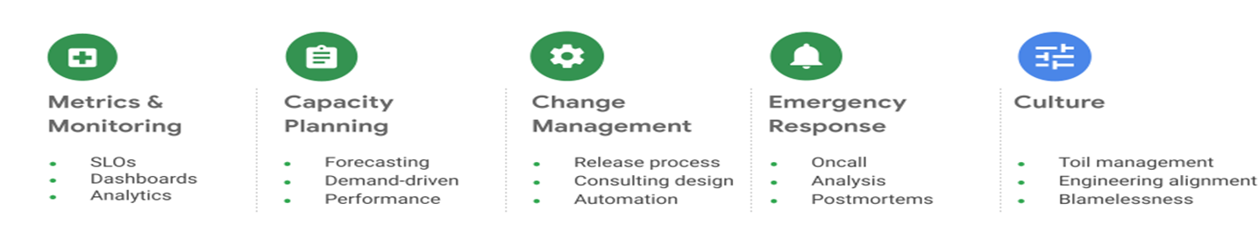
(Closed Loop) SRE
Practices –
For Further Exploration -
Site Reliability Engineering (SRE) Fundamentals
What is a Runbook? | PagerDuty
PagerDuty University
Runbook execution in Azure Automation | Microsoft Learn
Automation-Runbook-Gallery
SRE Fundamentals: Mastering Site Reliability Engineering | Udemy
Becoming-a-Rockstar-SRE: Becoming a Rockstar SRE
Real-World-SRE: Real-World SR

Slide 56
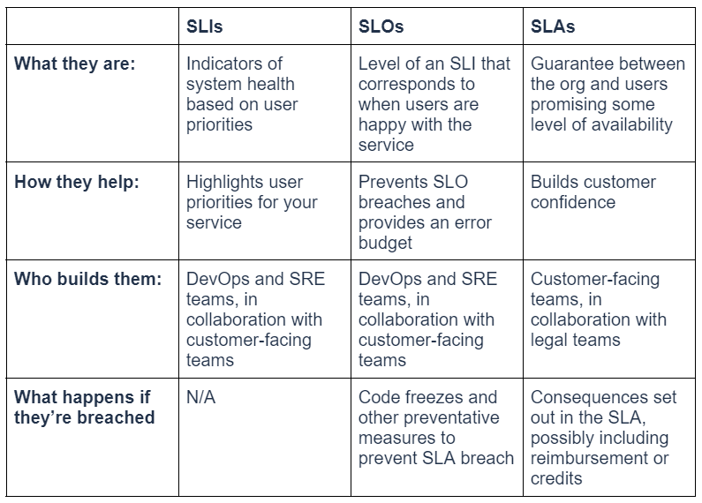
(Closed Loop) SRE
SLIs, SLOs And SLAs –

Slide 57
(Closed Loop) SRE
SLIs, SLOs And SLAs –
SLA -> SLO -> Error Budget
Converting a Service Level Agreement (SLA) to a Service Level Objective (SLO) and then into an Error Budget creates a data-driven framework for making risk-aware decisions. This process shifts focus from "avoiding all failures" to managing the permissible level of failure (unreliability) allowed to balance innovation and stability.
The Core Concepts
SLA (Service Level Agreement): The contractual, external-facing commitment to customers (e.g., 99.9% uptime), often tied to penalties.
SLO (Service Level Objective): An internal target (e.g., 99.95% uptime) set more stringently than the SLA to provide a safety buffer.
Error Budget: The allowed amount of unreliability within a time period, calculated as 100% - SLO
Step-by-Step Transformation
Define the SLA (The Goal): Identify the contractually binding uptime or performance goal, such as 99.9% availability.
Define the SLO (The Internal Target): Set an internal target that is stricter than the SLA. If the SLA is 99.9%, set the internal SLO at 99.95% to allow for early detection of issues before penalties occur.
Calculate the Error Budget (The Limit): The Error Budget is the inverse of the SLO.
Example: If your 30-day availability SLO is 99.9% ().
Calculation: 0.1% of a 30-day month is roughly 43.2 minutes of allowed downtime ().
Track the Burn Rate (The Monitoring): Monitor how quickly the error budget is consumed. A high burn rate suggests an imminent SLO breach.

Slide 58
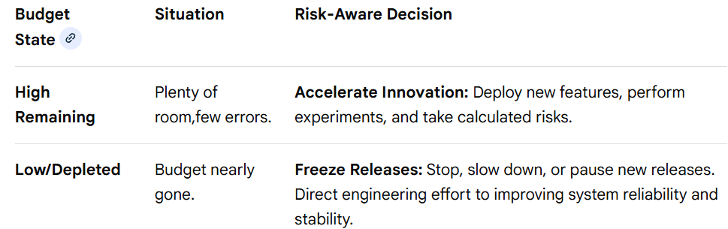
(Closed Loop) SRE
SLIs, SLOs And SLAs –
SLA -> SLO -> Error Budget
Best Practices and Implementation
Don't Aim for 100%: Perfection is impossible and prevents innovation; use the budget to take risks.
Use Realistic SLOs: Base SLOs on actual user experience rather than aspirational targets to avoid constant, demoralizing budget depletion.
Automate Alerts: Use burn rate alerts to detect when a budget is being consumed too fast, allowing for proactive intervention.
Shared Responsibility: Ensure both development and SRE teams are aligned on the current state of the error budget to prioritize work effectively.

Slide 59
(Closed Loop) SRE
SLIs, SLOs And SLAs –
For Further Exploration-
SLIs and SLOs versus NFRs | Mark Rendell
Concepts in service monitoring | Google Cloud Observability
A practical guide for implementing SLO | Last9
Complete Guide to Service Level Objectives (SLOs) That Work
Mastering Service Level Objectives (SLOs): A Complete Guide | Cortex
SLOs, SLIs, and SLAs: Meanings & Differences | New Relic
Implementing Service Level Objectives[Book]
Introducing our open source SLO Tracker - A simple tool to track SLOs and Error Budget | Squadcast

Slide 60
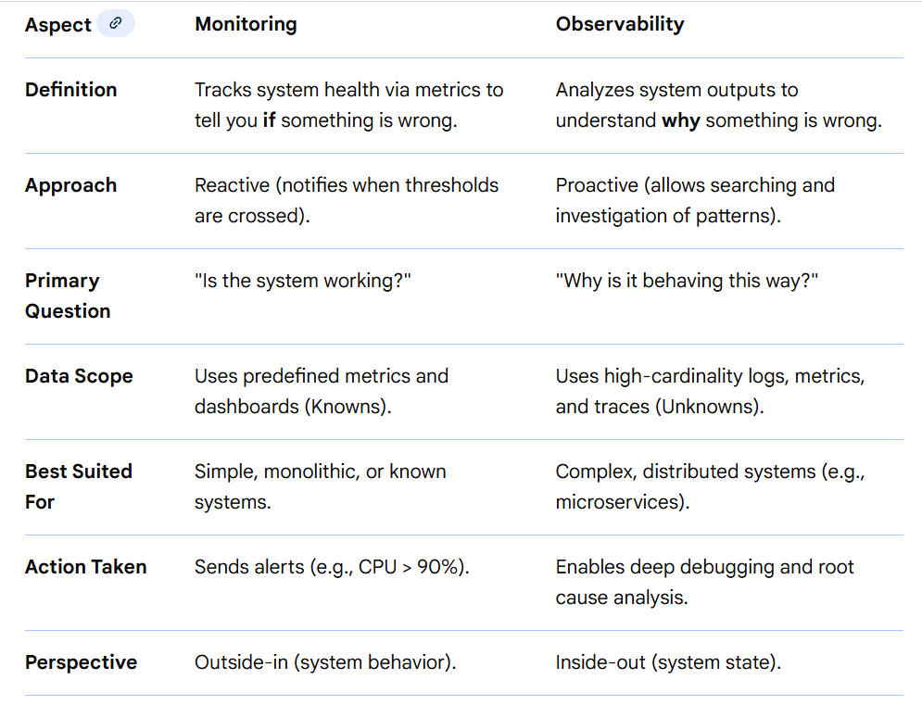
(Closed Loop) SRE
Monitoring vs Observability
Summary of Differences
Monitoring acts as a smoke detector—it alerts you to the presence of a problem (symptoms).
Observability acts as a fire investigator—it allows you to dig into logs and traces to understand the root cause.
Both are generally used together, with monitoring serving as a component within a broader observability strategy.

Slide 61
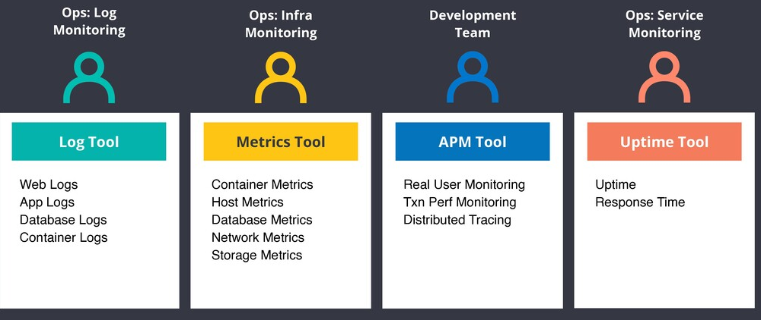
(Closed Loop) SRE
Observability/Monitoring using MELT(Metrics, Events, Logs And Traces) –
Can be used for monitoring Business Activity, Performance, Security, System Health, Cost (Controls) etc. Events are like actions taken(e.g. CRUD but can be more granular as in Event Driven DDD) & you may log them in DB as part of Auditing. By the way, any Batch Process should ideally have an associated Batch Observability table or Logs so that MELT specific stuffs w.r.t the Batch process can be tracked easily. Also, Dashboards, Alerts(if needed, based on data patterns) can be implemented based on observable data and Data Reconciliation can be done after that(if needed).Grafana is an awesome and simple tool to create Dashboards(if needed mismatched data can be seen for reconciliation as well) using logs/DB data & Grafana can create Alerts as well.

Slide 62
(Closed Loop) SRE
Key Concepts on Observability with Open Telemetry in .NET
Observability in .NET with OpenTelemetry relies on three pillars:
Distributed Tracing: Tracks the path of a single request across multiple services in a distributed system. Each operation within a trace is a span, which helps pinpoint performance bottlenecks and failures.
Metrics: Quantitative measurements of application health and performance over time (e.g., request counts, latency, CPU usage).
Logs: Contextual, human-readable records of events or errors that occurred within the application, which can be correlated with traces and spans for easier debugging.
Implementation in .NET
The .NET implementation of OpenTelemetry leverages built-in .NET APIs (System.Diagnostics.ActivitySource, System.Diagnostics.Metrics.Meter, Microsoft.Extensions.Logging) to collect data, which is then managed by the OpenTelemetry SDK.
Setup Steps
Install Necessary NuGet Packages: Add the core OpenTelemetry library and relevant instrumentation and exporter packages.
bash
dotnet add package OpenTelemetry.Extensions.Hosting
dotnet add package OpenTelemetry.Instrumentation.AspNetCore
dotnet add package OpenTelemetry.Exporter.OpenTelemetryProtocol
# Add other instrumentation packages for HttpClient, SqlClient, etc.
Configure OpenTelemetry in Program.cs: In a typical ASP.NET Core application, configure the services to add tracing, metrics, and logging, and specify an exporter. The OTLP (OpenTelemetry Protocol) exporter is the vendor-neutral default for sending data to a backend.

Slide 63
(Closed Loop) SRE
Implementation in .NET
Setup Steps
using OpenTelemetry.Metrics;
using OpenTelemetry.Trace;
// ...
builder.Services.AddOpenTelemetry()
.ConfigureResource(resource => resource.AddService("MyServiceName"))
.WithTracing(tracing =>
{
tracing.AddAspNetCoreInstrumentation();
tracing.AddHttpClientInstrumentation();
tracing.AddSource("MyCustomActivitySource"); // For manual spans
tracing.AddOtlpExporter();
})
.WithMetrics(metrics =>
{
metrics.AddAspNetCoreInstrumentation();
metrics.AddMeter("MyCustomMeter"); // For manual metrics
metrics.AddOtlpExporter();
});
// For logging, configure the logging builder
builder.Logging.AddOpenTelemetry(logging => logging.AddOtlpExporter());
Use an Observability Backend: OpenTelemetry is not a backend itself. You need a compatible tool (like Jaeger, Prometheus and Grafana, Azure Monitor Application Insights, or Splunk) to receive, store, and visualize the telemetry data. The OpenTelemetry Collector can be used to receive and route data to multiple backends.

Slide 64
(Closed Loop) SRE
Implementation in .NET
Best Practices
Monitoring and Alerting: For every service, monitor Error rate (should be close to 0%) ,Response time (p50, p95, p99 percentiles) ,Request rate (to detect traffic spikes) ,Database connection pool usage, Memory usage (to catch leaks) etc. Set up alerts for critical issues. But be careful—too many alerts and you'll ignore them all (alert fatigue is real).Alert on symptoms(latency increase, errors etc) that indicate SLO violation rather than raw resource thresholds.
Leverage Auto-Instrumentation: Use pre-built instrumentation packages for common libraries (ASP.NET Core, Entity Framework, HttpClient) to automatically capture data without manual code changes.
Implement Custom Instrumentation: For business-specific operations not covered by auto-instrumentation, use the ActivitySource and Meter APIs in your code to add custom spans and metrics.
Use Semantic Conventions: Follow the OpenTelemetry semantic conventions for naming spans and attributes to ensure consistency and compatibility across different tools and services.
Correlate Telemetry: Ensure logs are enriched with trace and span IDs to link all three observability signals, which is crucial for effective debugging in distributed systems.
Manage Data Volume with Sampling: In high-traffic production environments, configure sampling strategies to control the amount of data collected and minimize overhead.

Slide 65
(Closed Loop) SRE
MELT Lifecycle
🔁 High-level Flow
┌────────────────────────────┐
│ Application │
│ (instrumented with OTel) │
│ │
│ Metrics | Events | Logs │
│ Traces │
└──────────────┬────────────┘
│ OTLP / SDK Export
▼
┌────────────────────────────┐
│ Docker │
│ (container boundary) │
└──────────────┬────────────┘
│
▼

Slide 66
(Closed Loop) SRE
MELT Lifecycle
│
▼
┌──────────────────────────────────────────┐
│ Kubernetes │
│ │
│ Pod │
│ ├─ Your App Container │
│ └─ OpenTelemetry Collector (sidecar) │
│ OR │
│ Cluster OTel Collector (DaemonSet) │
│ │
└──────────────┬─────────────────────────┘
│ Process / Batch / Enrich
▼
┌──────────────────────────────────────────┐
│ Azure Application Insights │
│ (via OpenTelemetry Exporter) │
└──────────────────────────────────────────┘

Slide 67
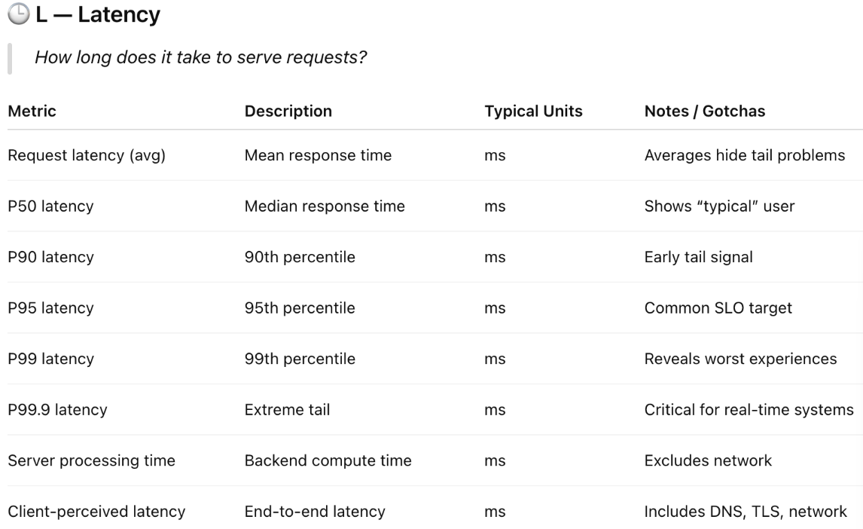
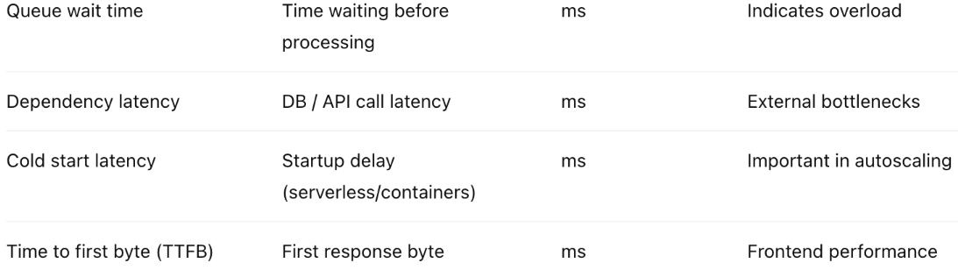
(Closed Loop) SRE
LETS(Latency, Error, Traffic, Saturation – The 4 Golden Signals of SRE) Approach

Slide 68
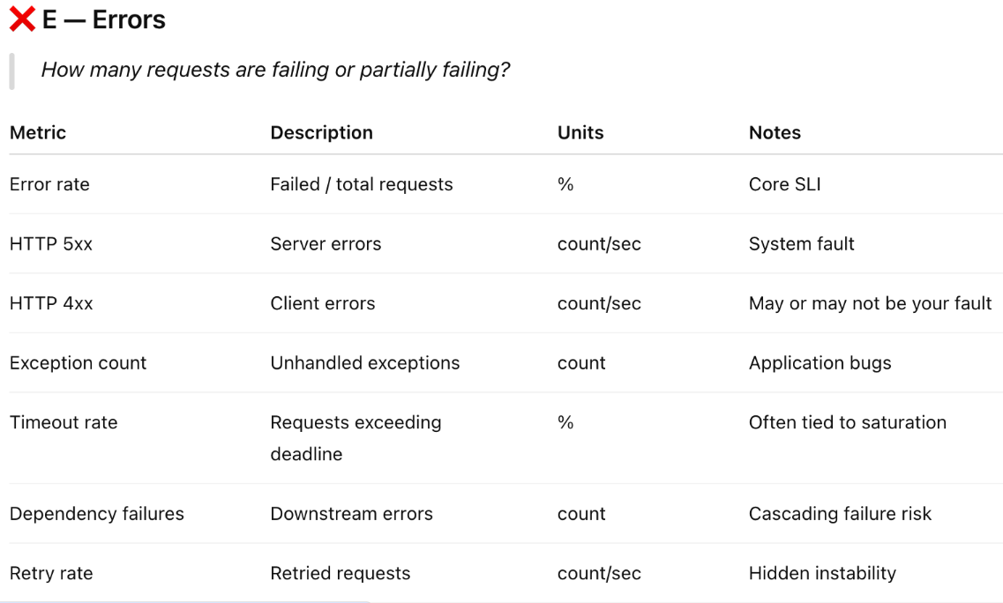
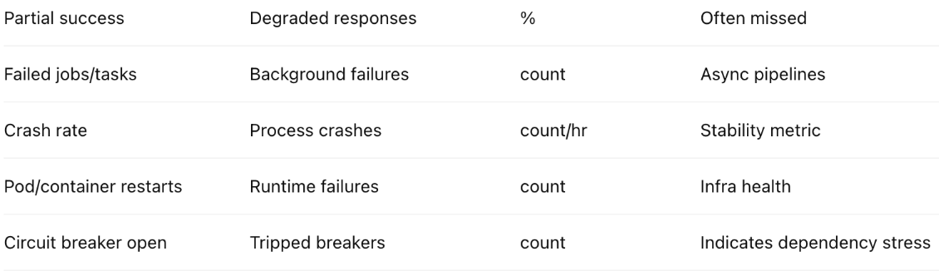
(Closed Loop) SRE
LETS(Latency, Error, Traffic, Saturation – The 4 Golden Signals of SRE) Approach

Slide 69
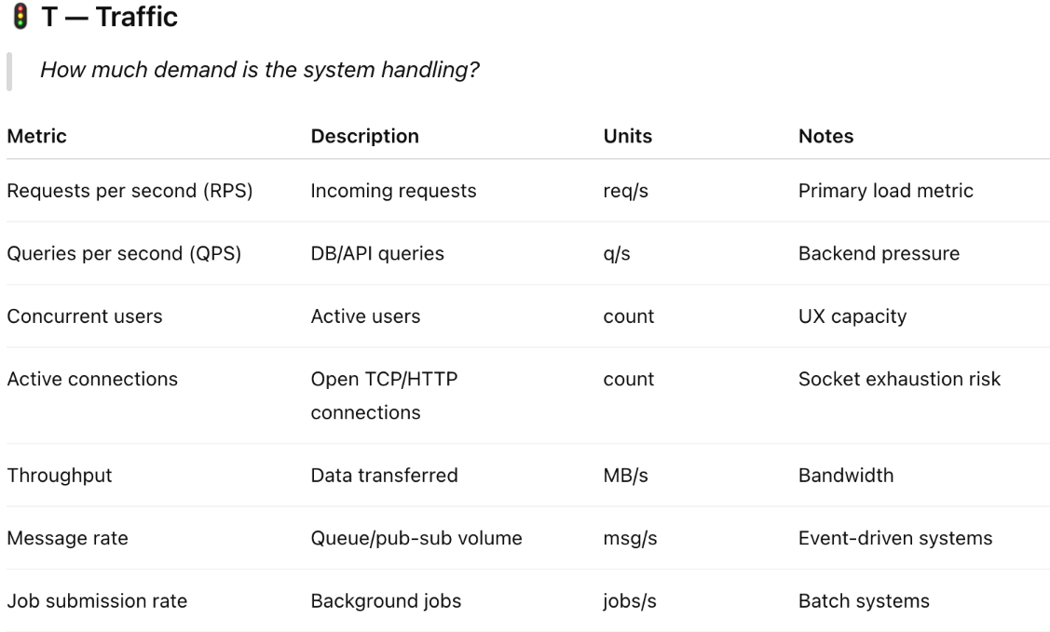
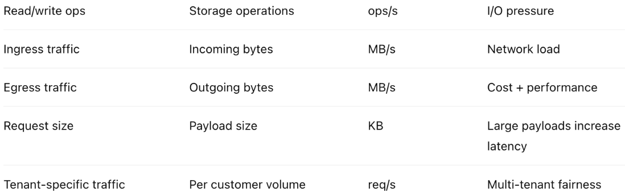
(Closed Loop) SRE
LETS(Latency, Error, Traffic, Saturation – The 4 Golden Signals of SRE) Approach

Slide 70
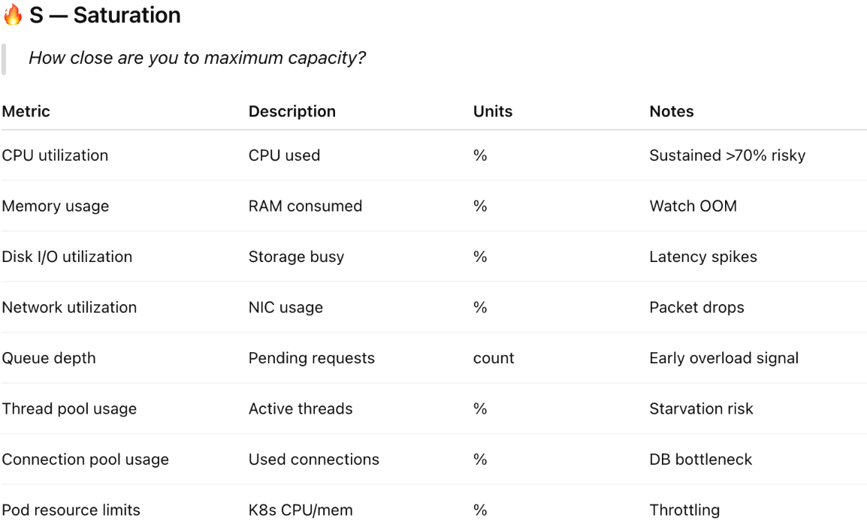
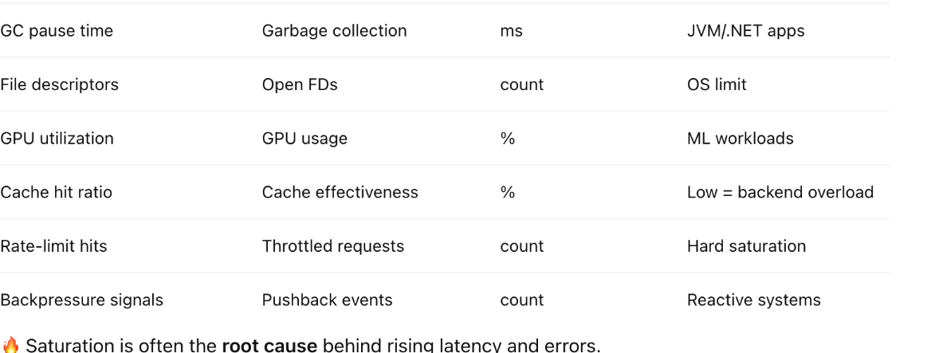
(Closed Loop) SRE
LETS(Latency, Error, Traffic, Saturation – The 4 Golden Signals of SRE) Approach

Slide 71
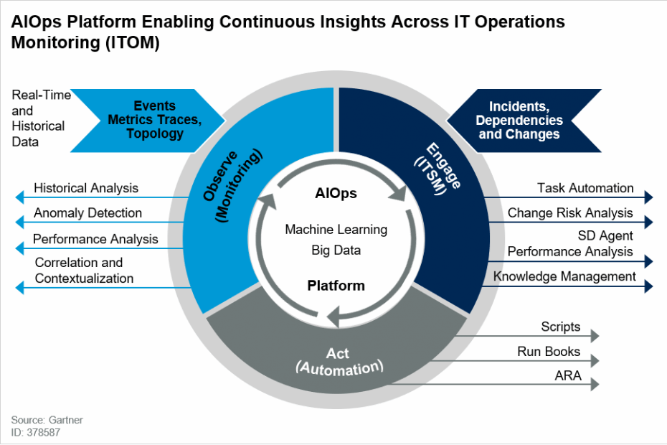
(Closed Loop) SRE
For Further Exploration –
What Is AIOps? Artificial Intelligence for IT Operations | Pure Storage
Point of View on DevSecOps and SRE - Key Asks and Considerations | LinkedIn

Slide 72
(Closed Loop) SRE
For Further Exploration
.NET Observability with OpenTelemetry - .NET | Microsoft Learn
Health checks in ASP.NET Core | Microsoft Learn
Kusto Query Language (KQL) overview - Kusto | Microsoft Learn(Requests, Dependencies, Exceptions & Traces [& maybe KubeEvents] are some important AppInsights tables that can be queried for various types of Analytics and Visualizations. Also, an operation spans cross-sectionally over these tables and so if you want to join across these tables, operation_Id is one of the best candidates for the same)
Create monitoring resources by using Bicep - Azure Resource Manager
Visualize Azure Monitor data with Grafana - Azure Monitor | Microsoft Learn
Google SRE book- Comprehensive guide to site reliability
Top Udemy OpenTelemetry Courses Online
Top Udemy Grafana Courses Online
Top Udemy Prometheus Software Courses Online
Observability as Code Explained: Benefits & How to Get Started
Observability as code | Grafana documentation
Observability as Code: Why You Should Use OaC | Splunk
The Complete Guide to Runbook Automation Tools in the Era of Real-Time IT
The four Golden Signals of Monitoring
What are golden signals?
Why You Need to Monitor the Four Golden Signals
4 SRE Golden Signals (What they are and why they matter)
USE and RED Method | PagerTree
Kubernetes Dashboard | Grafana Labs

Slide 73
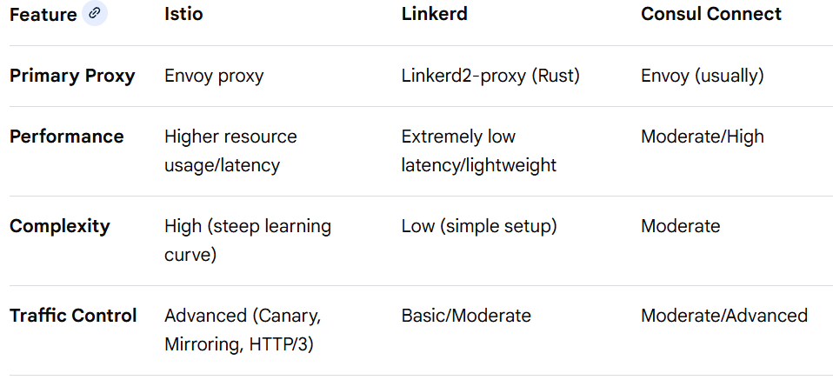
Service Mesh
A service mesh is an infrastructure layer for managing service-to-service communication in microservices, using sidecar proxies (e.g., Envoy proxy) to handle networking, security, and observability without altering application code. It is essential for implementing zero-trust security (mTLS), advanced traffic management (canary releases), and gaining visibility into distributed systems. Key choices include Istio (feature-rich), Linkerd (lightweight/fast), and HashiCorp Consul (multi-platform).
Why Do We Need a Service Mesh?
Security (mTLS): Automatically encrypts and authenticates service-to-service traffic without application changes.
Observability: Provides deep insights into metrics, logging, and tracing (latency, error rates).
Traffic Management: Enables fine-grained control, such as canary deployments, A/B testing, load balancing, and retries.
Resilience: Implements circuit breakers and timeouts to prevent service failures
N.B. – Mainly used for inter/intra microservices communication
Istio vs Linkerd vs Consul

Slide 74
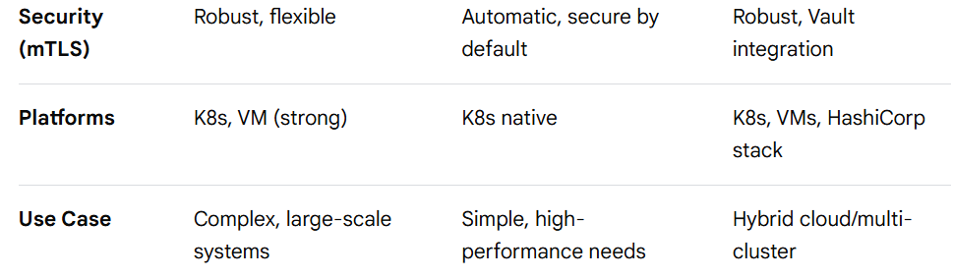
Service Mesh
Istio vs Linkerd vs Consul
Summary of Differences
Istio is chosen for its extensive feature set and customization.
Linkerd is preferred for its operational simplicity and performance efficiency.
Consul excels in connecting services across heterogeneous environments, including VMs.
Observability: Istio provides comprehensive, detailed dashboards, whereas Linkerd offers focused, essential metrics with less overhead.
Operational Burden: Istio requires more management, while Linkerd is designed for "it just works".

Slide 75
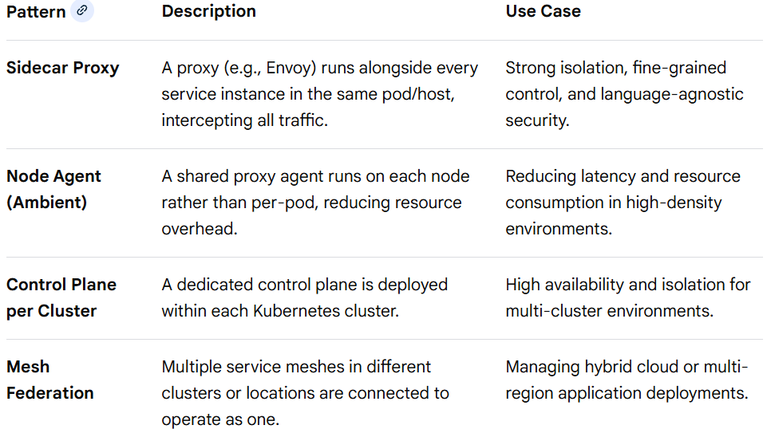
Service Mesh
Service Mesh Patterns
Service mesh patterns are architectural, operational, and traffic management strategies used to handle the complexity of inter-service communication in microservices, often implemented using tools like Istio, Linkerd, or Consul. These patterns provide a standardized way to manage security, observability, and traffic flow.
Architectural Patterns

Slide 76
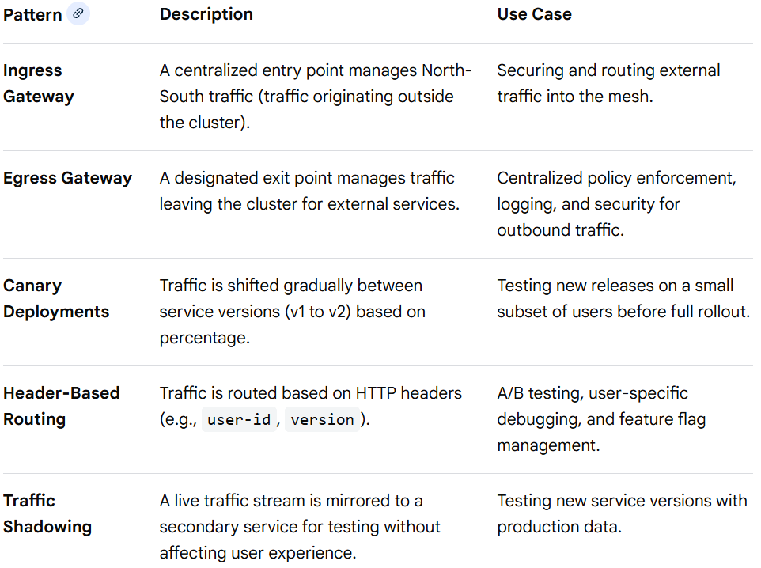
Service Mesh
Service Mesh Patterns
Traffic Management and Routing Patterns

Slide 77
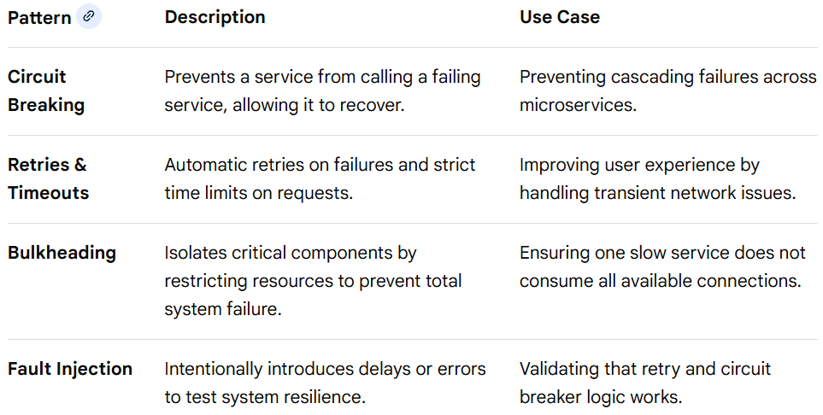
Service Mesh
Service Mesh Patterns
Reliability & Resiliency Patterns

Slide 78
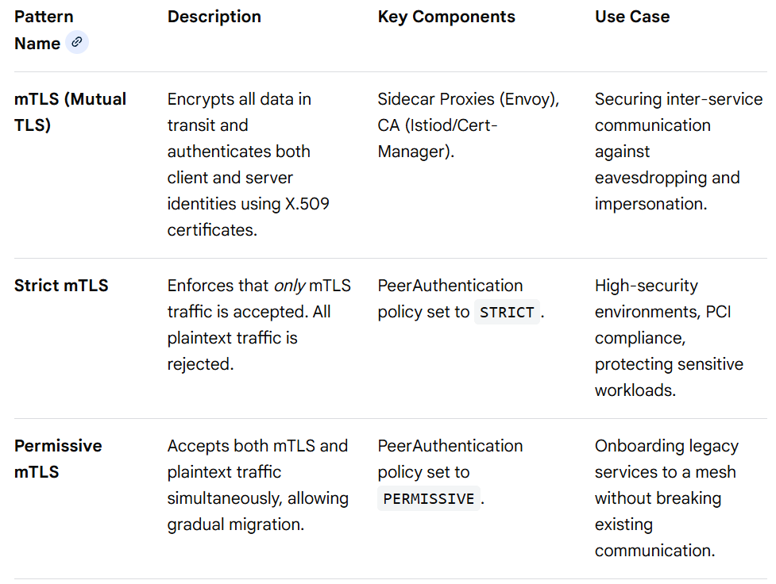
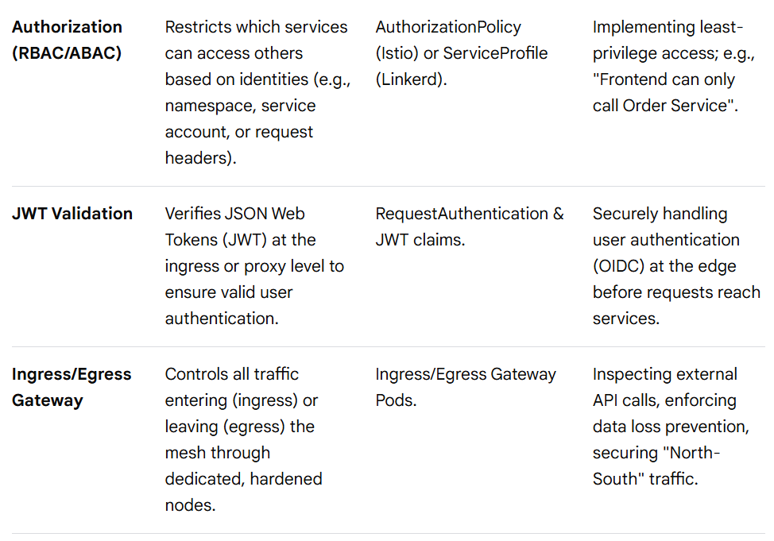
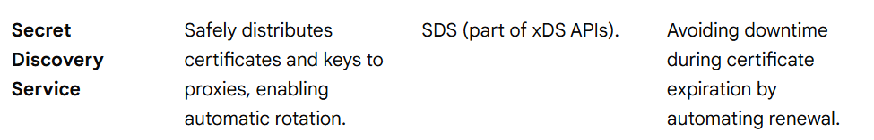
Service Mesh
Service Mesh Patterns
Security Patterns

Slide 79
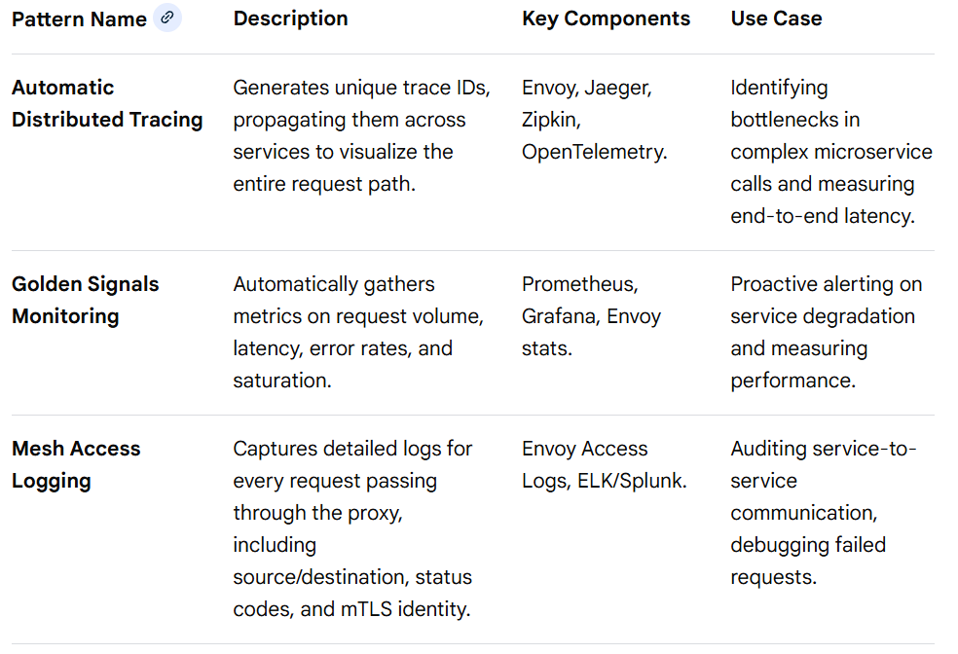
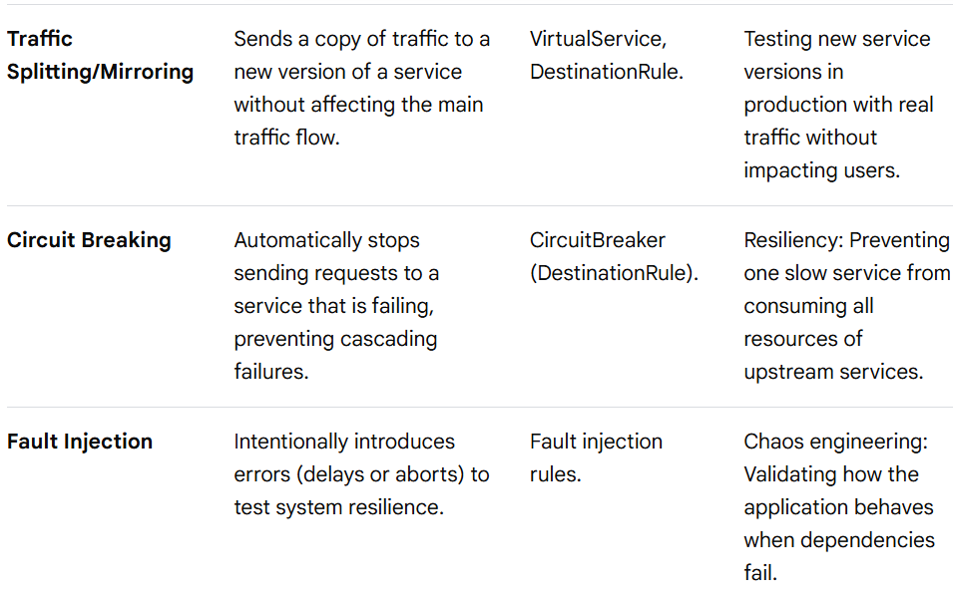
Service Mesh
Service Mesh Patterns
Observability Patterns

Slide 80
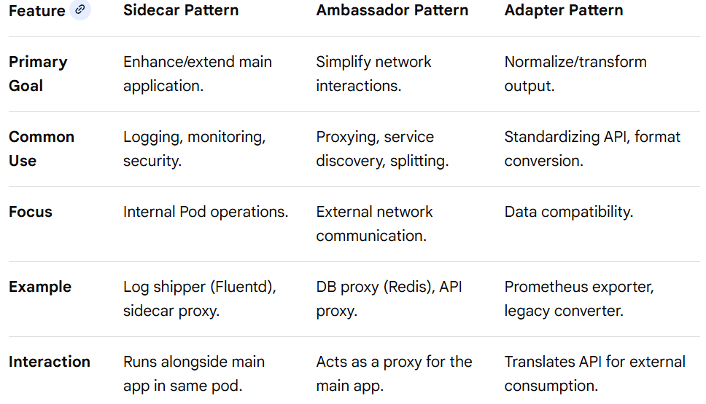
Service Mesh
Sidecar vs Ambassador vs Adapter
Key Distinctions:
Sidecar: Broadest term; any container that helps the main application.
Ambassador: A specialized sidecar focused on network proxying for traffic in/out of the pod.
Adapter: A specialized sidecar focused on transforming data to a standard format.

Slide 81
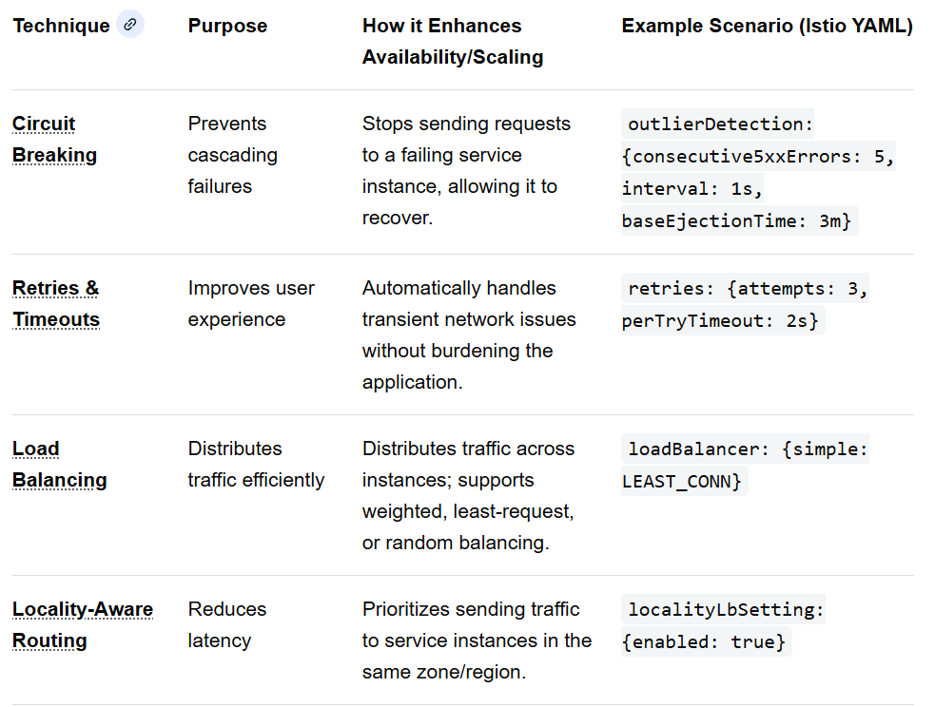
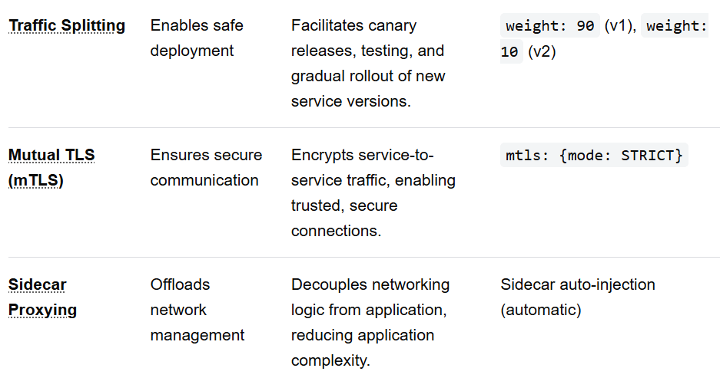
Service Mesh
Service Mesh Scaling and Availability Techniques

Slide 82
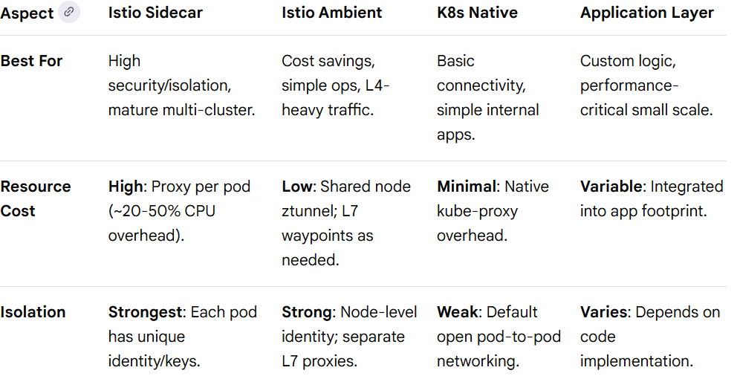
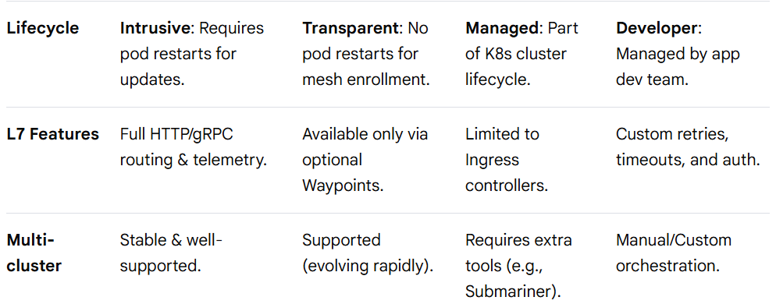
Service Mesh
Service Mesh vs Alternatives

Slide 83
Service Mesh
Service Mesh vs Alternatives
Decision Guide
Use Istio Sidecar if:
You require strict security isolation where each pod must have its own identity and dedicated proxy.
You need per-pod customization using the EnvoyFilter API (unsupported in Ambient).
You are already running a mature sidecar-based mesh and don't want the risk of migrating yet.
Use Istio Ambient if:
Your primary goal is resource efficiency (reducing CPU/RAM costs by up to 70-90%).
You only need L4 features like mutual TLS (mTLS) and basic TCP telemetry.
You want to onboard services gradually without restarting existing application pods.
Stick with K8s Native if:
You have a small, simple cluster where basic NetworkPolicies for security and standard Services for load balancing are sufficient.
Your environment cannot tolerate the added operational overhead of managing any service mesh control plane.
Handle in Application if:
You have ultra-low latency requirements where even a 0.2ms - 0.5ms proxy hop is unacceptable.
The required functionality is highly business-logic specific (e.g., complex custom retries based on specific payload content).

Slide 84
Service Mesh
For Further Exploration
What is a Service Mesh? | Definition from TechTarget
Microservice Service Discovery: Service Mesh vs API Gateway Explained
How to implement security for microservices
Kubernetes-Service-Mesh-with-Istio
What Is Istio? | Google Cloud
Istio Succinctly
Mastering-Service-Mesh: Mastering Service Mesh, published by Packt
Mastering-Service-Mesh-Architecture
Bootstrap-Service-Mesh-Implementations-with-Istio
Service Mesh Interface Conformance with Meshery
The Enterprise Path to Service Mesh Architectures (2nd Edition)
Service Mesh Patterns | Service Mesh Patterns
Service Mesh in Microservices | Feed | LinkedIn
Istio Docs
Some Service Mesh Notes

Slide 85
Docker + DevSecOps + K8s + SRE Workflow
Hosting Kubernetes (K8s)-based applications involves integrating Docker for containerization, DevSecOps for embedding security throughout the pipeline, Kubernetes for orchestration, and Site Reliability Engineering (SRE) principles for ensuring production reliability. This process is structured around a secure, automated CI/CD pipeline and ongoing operational excellence.
I. Development Phase: Code & Containerization (Docker)
The process begins with the development of the application and its containerization using Docker.
Secure Coding: Developers write code following secure coding best practices. Security is "shifted left," using IDE plugins to identify vulnerabilities early.
Containerization: A Dockerfile is created to package the application and its dependencies into a Docker image. Best practices include using minimal, trusted base images (e.g., Alpine or Distroless), running containers as non-root users, and only exposing necessary ports to reduce the attack surface.
Version Control: The source code and Dockerfile are stored in a version control system (e.g., Git), which triggers the CI/CD pipeline upon changes.
II. CI/CD Pipeline Phase: Build, Test, & Secure (DevSecOps)
The CI/CD pipeline automates the build process while integrating security checks at every stage.
Build & Static Analysis (CI):
Image Building: The CI server (e.g., Jenkins, GitLab CI) builds the Docker image from the Dockerfile.
SAST & SCA: Static Application Security Testing (SAST) is performed on the source code, and Software Composition Analysis (SCA) scans dependencies for known vulnerabilities using tools like SonarQube or Snyk.
Container Image Scanning: The newly built Docker image is scanned for vulnerabilities (CVEs) using tools like Trivy or Clair. Builds fail automatically if critical vulnerabilities are detected.
Registry & Signing:
The secure, scanned image is pushed to a trusted container registry (e.g., GitHub Container Registry, Azure Container Registry).
Image signing (e.g., using Docker Content Trust or Notation) ensures image integrity and authenticity.

Slide 86
Docker + DevSecOps + K8s + SRE Workflow
II. CI/CD Pipeline Phase: Build, Test, & Secure (DevSecOps)
Deployment Configuration (IaC): Kubernetes manifests (YAML files, Helm charts, or Kustomize files) defining the deployment are created and stored as Infrastructure as Code (IaC) in a Git repository. IaC scanning tools (e.g., kube-score) check for Kubernetes misconfigurations and security best practices violations.
III. Deployment Phase: Orchestration (Kubernetes)
Kubernetes orchestrates the deployment and management of the containerized application in the target environment (staging, production).
Pull & Verify: The K8s cluster pulls the signed image from the trusted registry. Admission controllers verify the image signature and enforce security policies (e.g., preventing privileged containers) before deployment.
Secure Deployment: The K8s manifest is applied to the cluster, creating pods, services, and other resources.
Secrets Management: Sensitive information (credentials, API keys) is stored in a secure external vault (e.g., HashiCorp Vault, Azure Key Vault) or Kubernetes Secrets (encrypted at rest), not hardcoded in the image or manifests.
Network Policies: Kubernetes network policies are applied to restrict traffic flow between application pods and other services, implementing the principle of least privilege.
Runtime Security: Runtime monitoring tools (e.g., Falco) are used to detect anomalous activities, such as unusual process execution or network calls, in running containers.
IV. Operations Phase: Reliability & Monitoring (SRE)
SRE principles and practices ensure the deployed application is reliable, scalable, and highly available in production.
Defining SLOs/SLIs: The SRE team defines Service Level Objectives (SLOs) and Service Level Indicators (SLIs) based on user experience (e.g., latency, availability, error rates for the UI). These metrics guide operational priorities.
Monitoring & Observability:
Metrics & Logging: Tools like Prometheus (for metrics) and Grafana (for visualization), along with centralized logging systems (e.g., EFK stack), provide comprehensive visibility into the application and cluster health.

Slide 87
Docker + DevSecOps + K8s + SRE Workflow
IV. Operations Phase: Reliability & Monitoring (SRE)
Alerting: Automated alerts are configured based on SLO breaches or suspicious security activities, paging the SRE team only for actionable incidents to reduce alert fatigue.
Automation & Self-Healing:
Scaling: Kubernetes' Horizontal Pod Autoscaler (HPA) automatically adjusts the number of application pods based on load or resource usage, ensuring performance under demand and optimal resource utilization.
Incident Management: SREs automate incident responses where possible. Kubernetes' built-in self-healing capabilities (restarting failed pods, rescheduling on healthy nodes) minimize downtime.
Automated Rollbacks: The CI/CD pipeline includes automated rollback procedures to revert to a previous stable state if a new deployment causes issues or breaches SLOs.
Chaos Engineering: The SRE team might inject failures intentionally (e.g., using LitmusChaos to kill a pod) in testing environments to verify the system's resilience and refine disaster recovery plans.
By following these integrated steps, organizations can establish a robust, secure, and highly reliable system for hosting K8s-based applications.

Slide 88
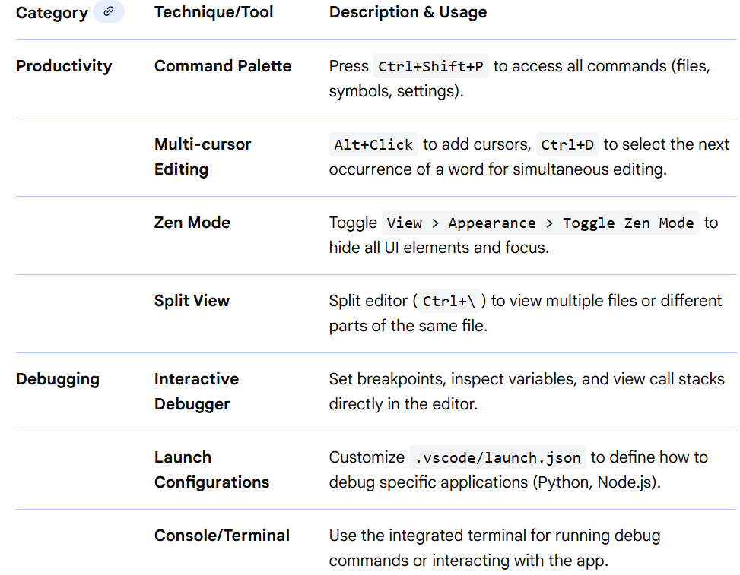
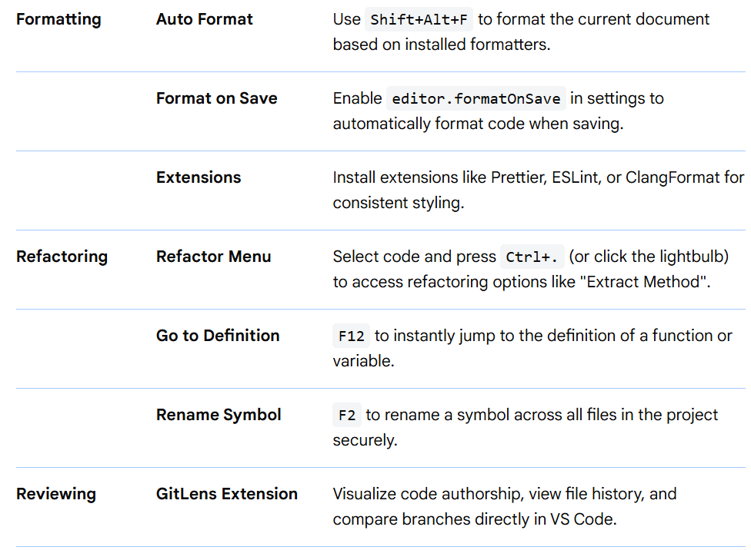
VS Code & Community Edition Useful Tools

Slide 89

VS Code & Community Edition Useful Tools
VS Code Specifics
Extensions Marketplace: Customize your environment for any language (Python, C++, JS).
Settings Sync: Sign in to sync settings and extensions across devices.
Keymaps: Install extensions to mimic keybindings from other IDEs (e.g., IntelliJ, Sublime).
Visual Studio Community Edition Specifics
CodeLens: Displays references, changes, and unit test status directly above code definitions.
Task List: Track TODOs and comments across the project.
ClangFormat: Built-in support for C++ code formatting.

Slide 90
VS Code & Community Edition Useful Tools
For Further Exploration
Visual Studio Code vs Visual Studio 2022 Professional: Comprehensive Comparison | LinkedIn
Debugging techniques and tools - Visual Studio (Windows) | Microsoft Learn
Why did we build Visual Studio Code?
Visual Studio Code: Read this before you get started
Tricks Every Developer Should Know in Visual Studio Code
Visual Studio Code tips and tricks
VSCode Guide
Efficient coding, debugging, & keyboard shortcuts - Visual Studio (Windows) | Microsoft Learn
Refactoring
CodeMetrics - Visual Studio Marketplace
Resource Monitor - Visual Studio Marketplace
Editor Overview - Visual Studio (Windows) | Microsoft Learn

Slide 91
Production Debugging
Production bugs are different from development bugs. The stakes are higher and the debugging tools are more limited.
First steps:
Assess severity (is money being lost? are users blocked?)
Stop the bleeding (rollback if needed)
Gather information (logs, error reports, user reports)
Form hypotheses (what changed recently?)
Test in staging (don't test fixes in production)
Post-mortem process:
What happened?
What was the impact?
What was the root cause?
How do we prevent this?
What monitoring would have caught this?

Slide 92
Thank You

